Slide 1


Dynamic Patch Analysis of Coastal Mangroves in Indonesia
Ben Gaskill (bgaskill@clarku.edu)
Claire Goldberg (cfurgoldberg@clarku.edu
Philipp Steinhilber (psteinhilber@clarku.edu)
Isack Walube (iwalube@clarku.edu)

Slide 2
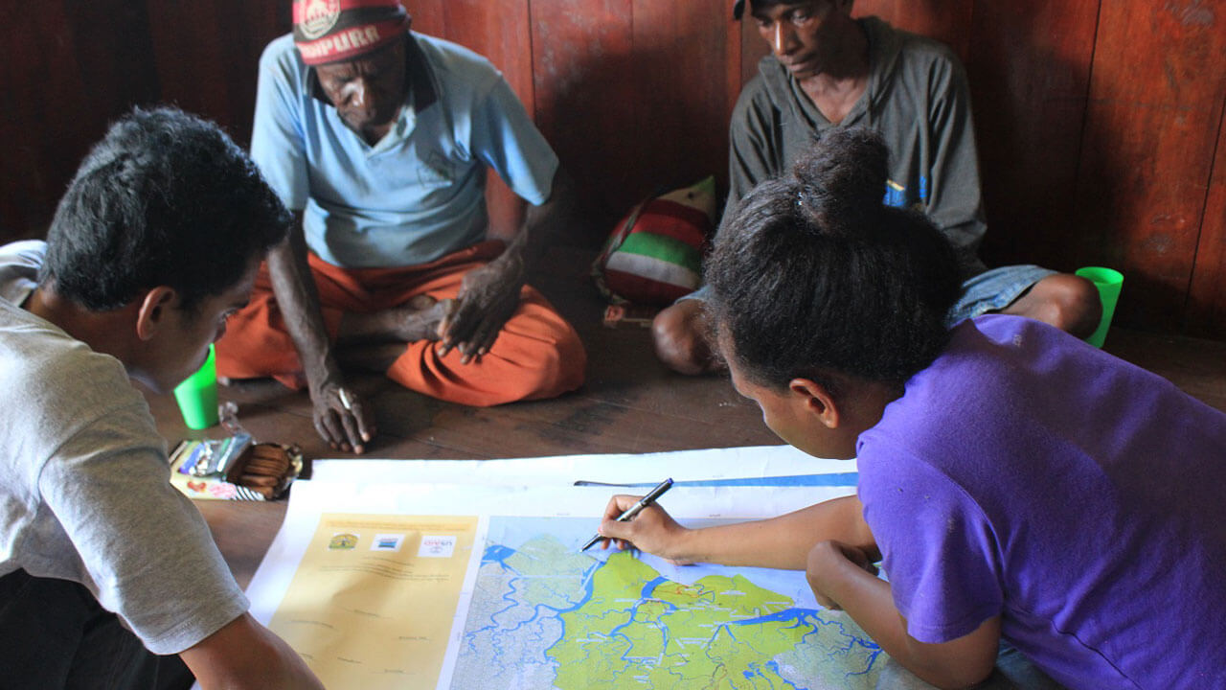
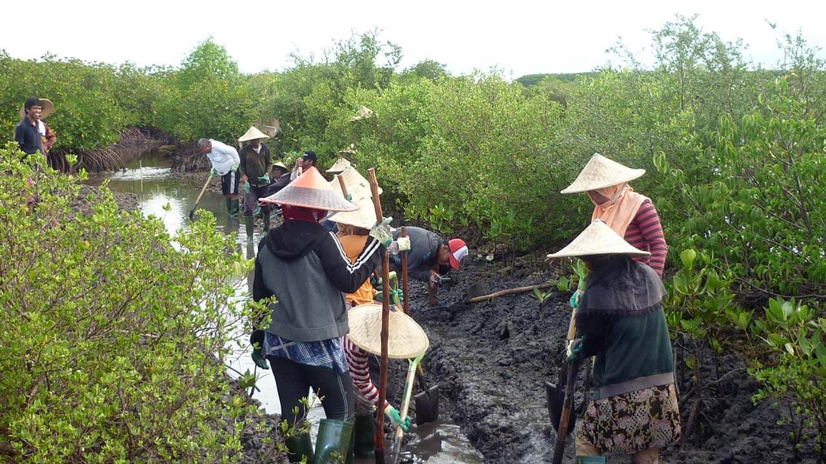
Background
Blue Forests is an Indonesia-based organization dedicated to Mangrove rehabilitation
The organization uses Clark Labs data to understand where Mangroves used to be, and then target those former sites for restoration
Former mangrove areas are most suitable for rehabilitating mangroves
SOURCE: Blue Forests

Slide 3
Research Goals
Provide feedback to Aiyin Zhang about the utility of DynamicPATCH from a user-perspective
Provide additional data to Blue Forests about the dynamics of land change in areas most useful to them (primarily Muna Island)
Document a guide to using DynamicPATCH and show the results of our Muna Island case study on this GitHub Repository

Slide 4
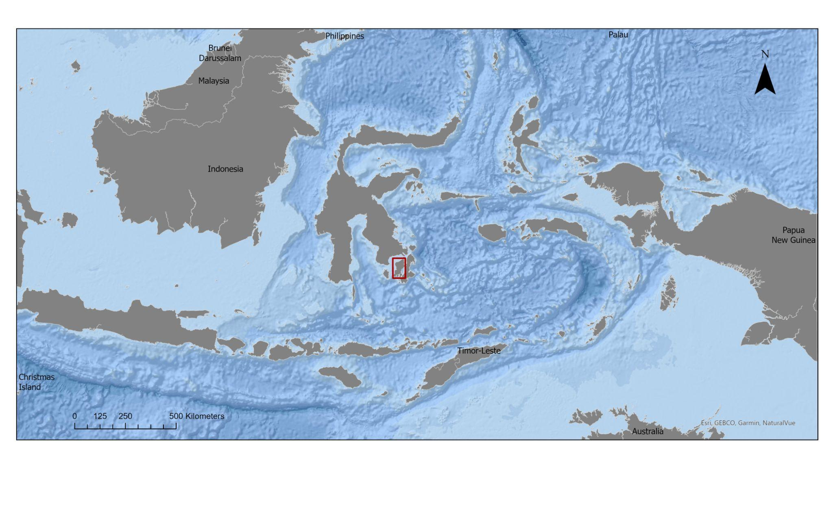
Study Area

Slide 5
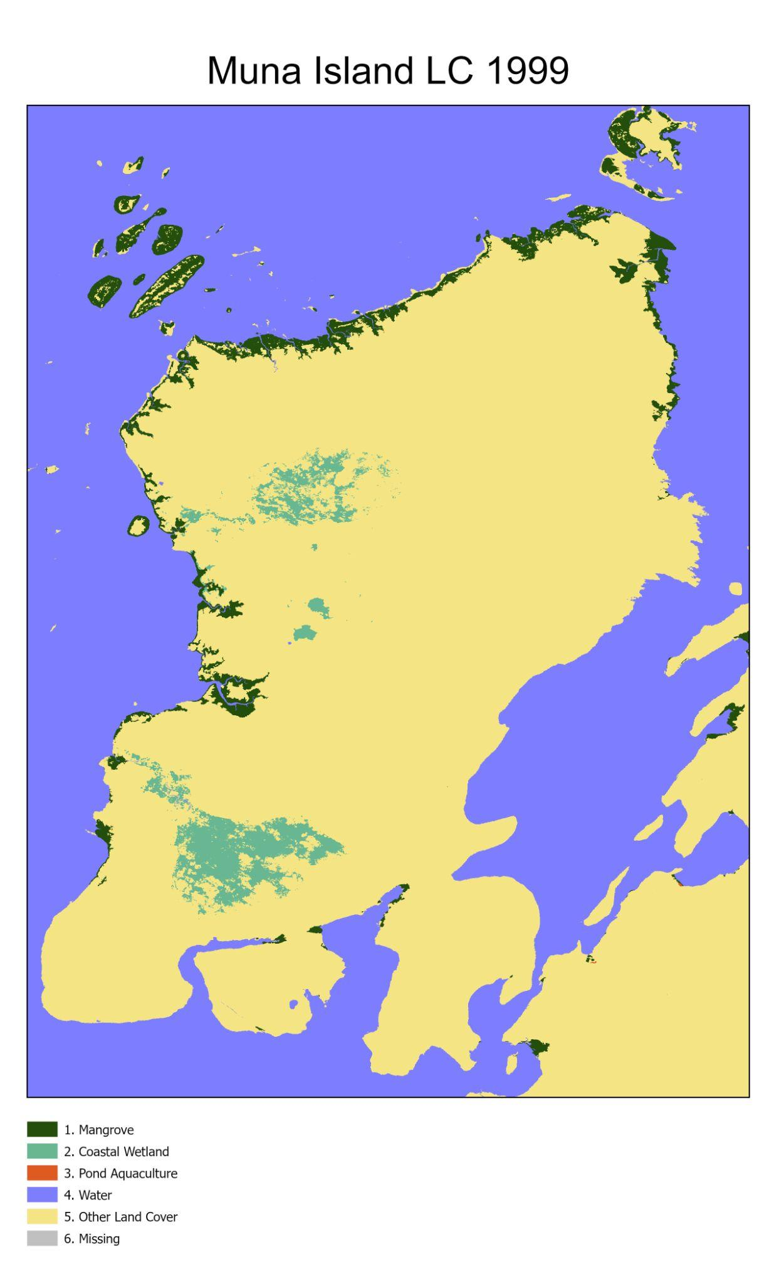
Land Cover data for Muna Island for the years 1999
2014
2018
2020
2022

Slide 6
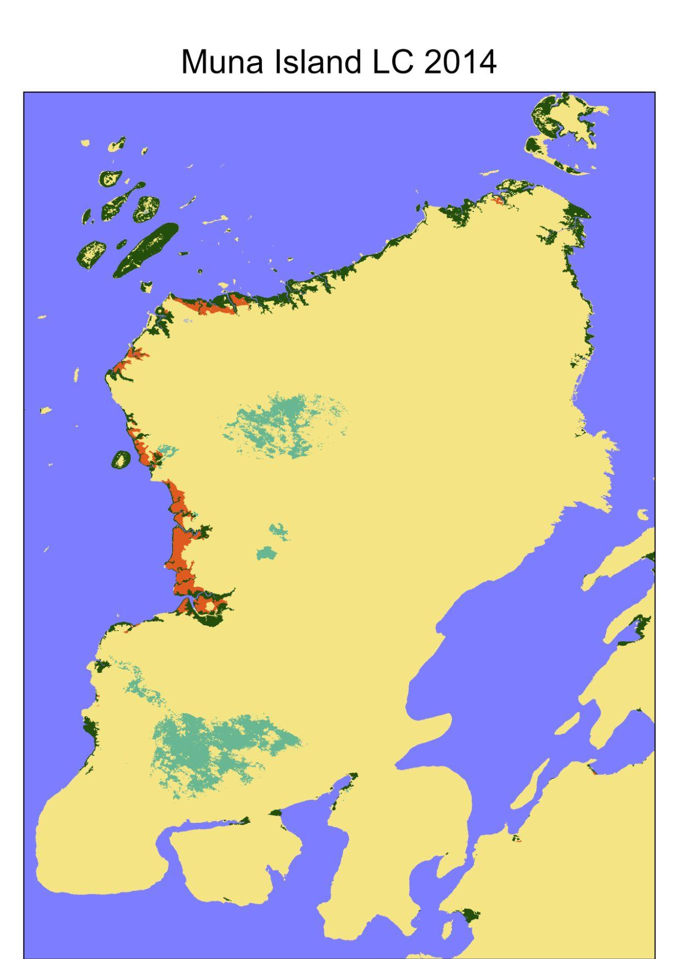
Land Cover data for Muna Island for the years 1999
2014
2018
2020
2022

Slide 7

Land Cover data for Muna Island for the years 1999
2014
2018
2020
2022

Slide 8

Land Cover data for Muna Island for the years 1999
2014
2018
2020
2022

Slide 9

Land Cover data for Muna Island for the years 1999
2014
2018
2020
2022

Slide 10
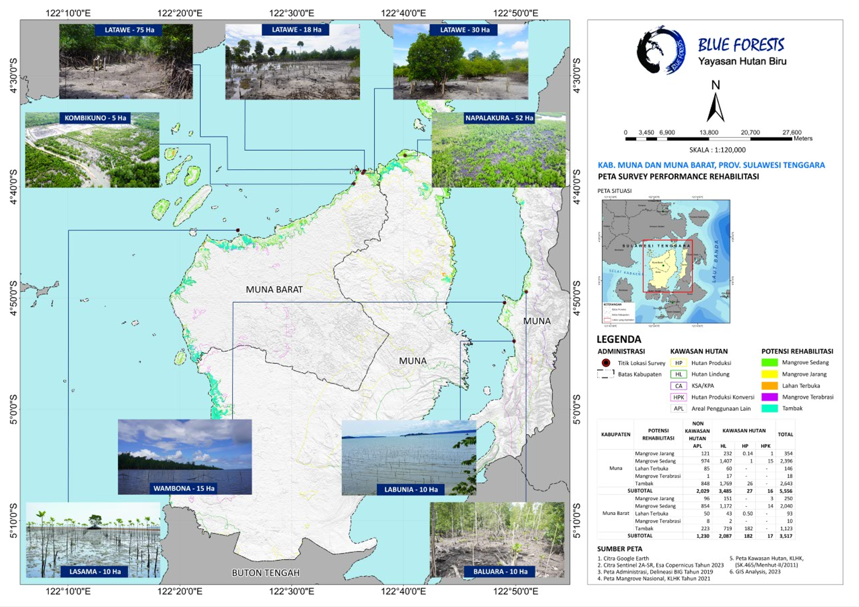
Initial mangrove rehabilitation sites identified by Blue Forests

Slide 11
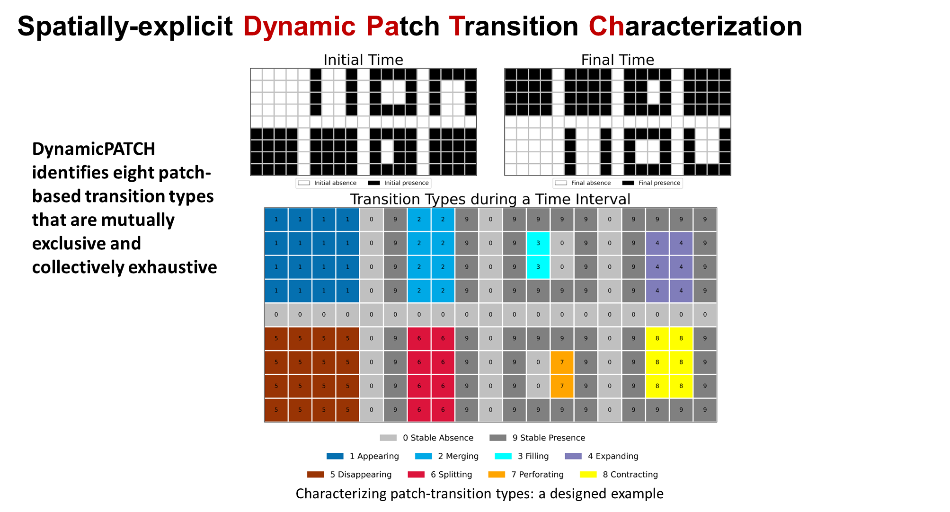
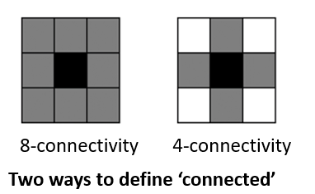
About DynamicPATCH
SOURCE: Aiyin Zhang
https://github.com/zay1996/DynamicPATCH

Slide 12
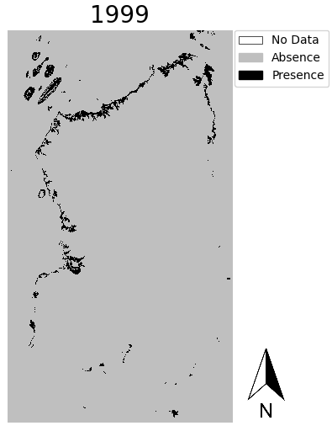
Workflow
Installed DynamicPATCH package. It only worked on 2 out of 4 computers (there were issues with miniconda detection and the order of installation steps taken. We created our own, more detailed instructions that we hope are more useful.
Reclassified raw data to show Mangrove presence (1) and absence (0) for all time intervals. NoData values also had to be reclassified to 2 for the program to run.
Clipped the data to the extent of Muna Island

Slide 13
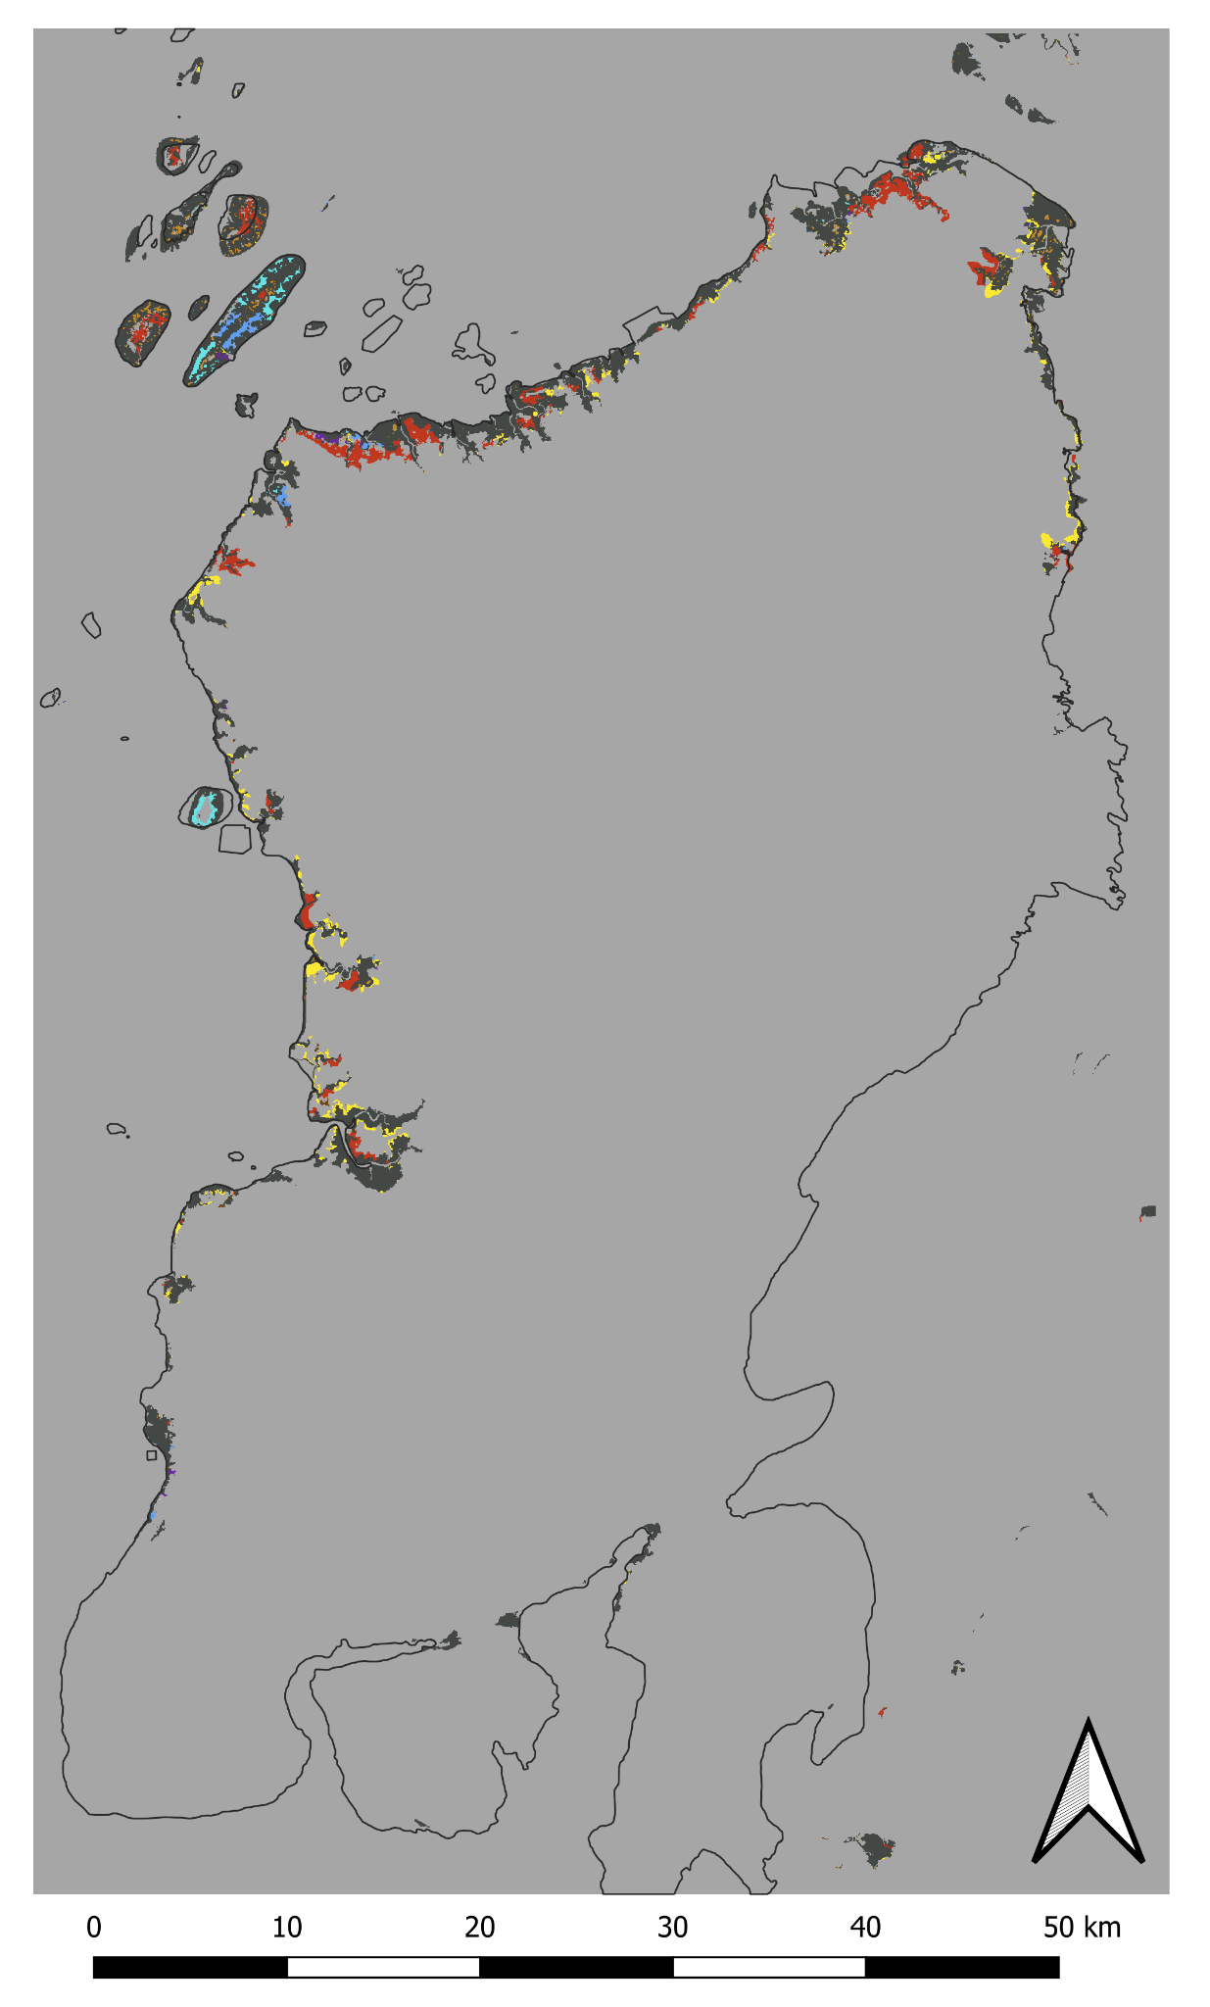
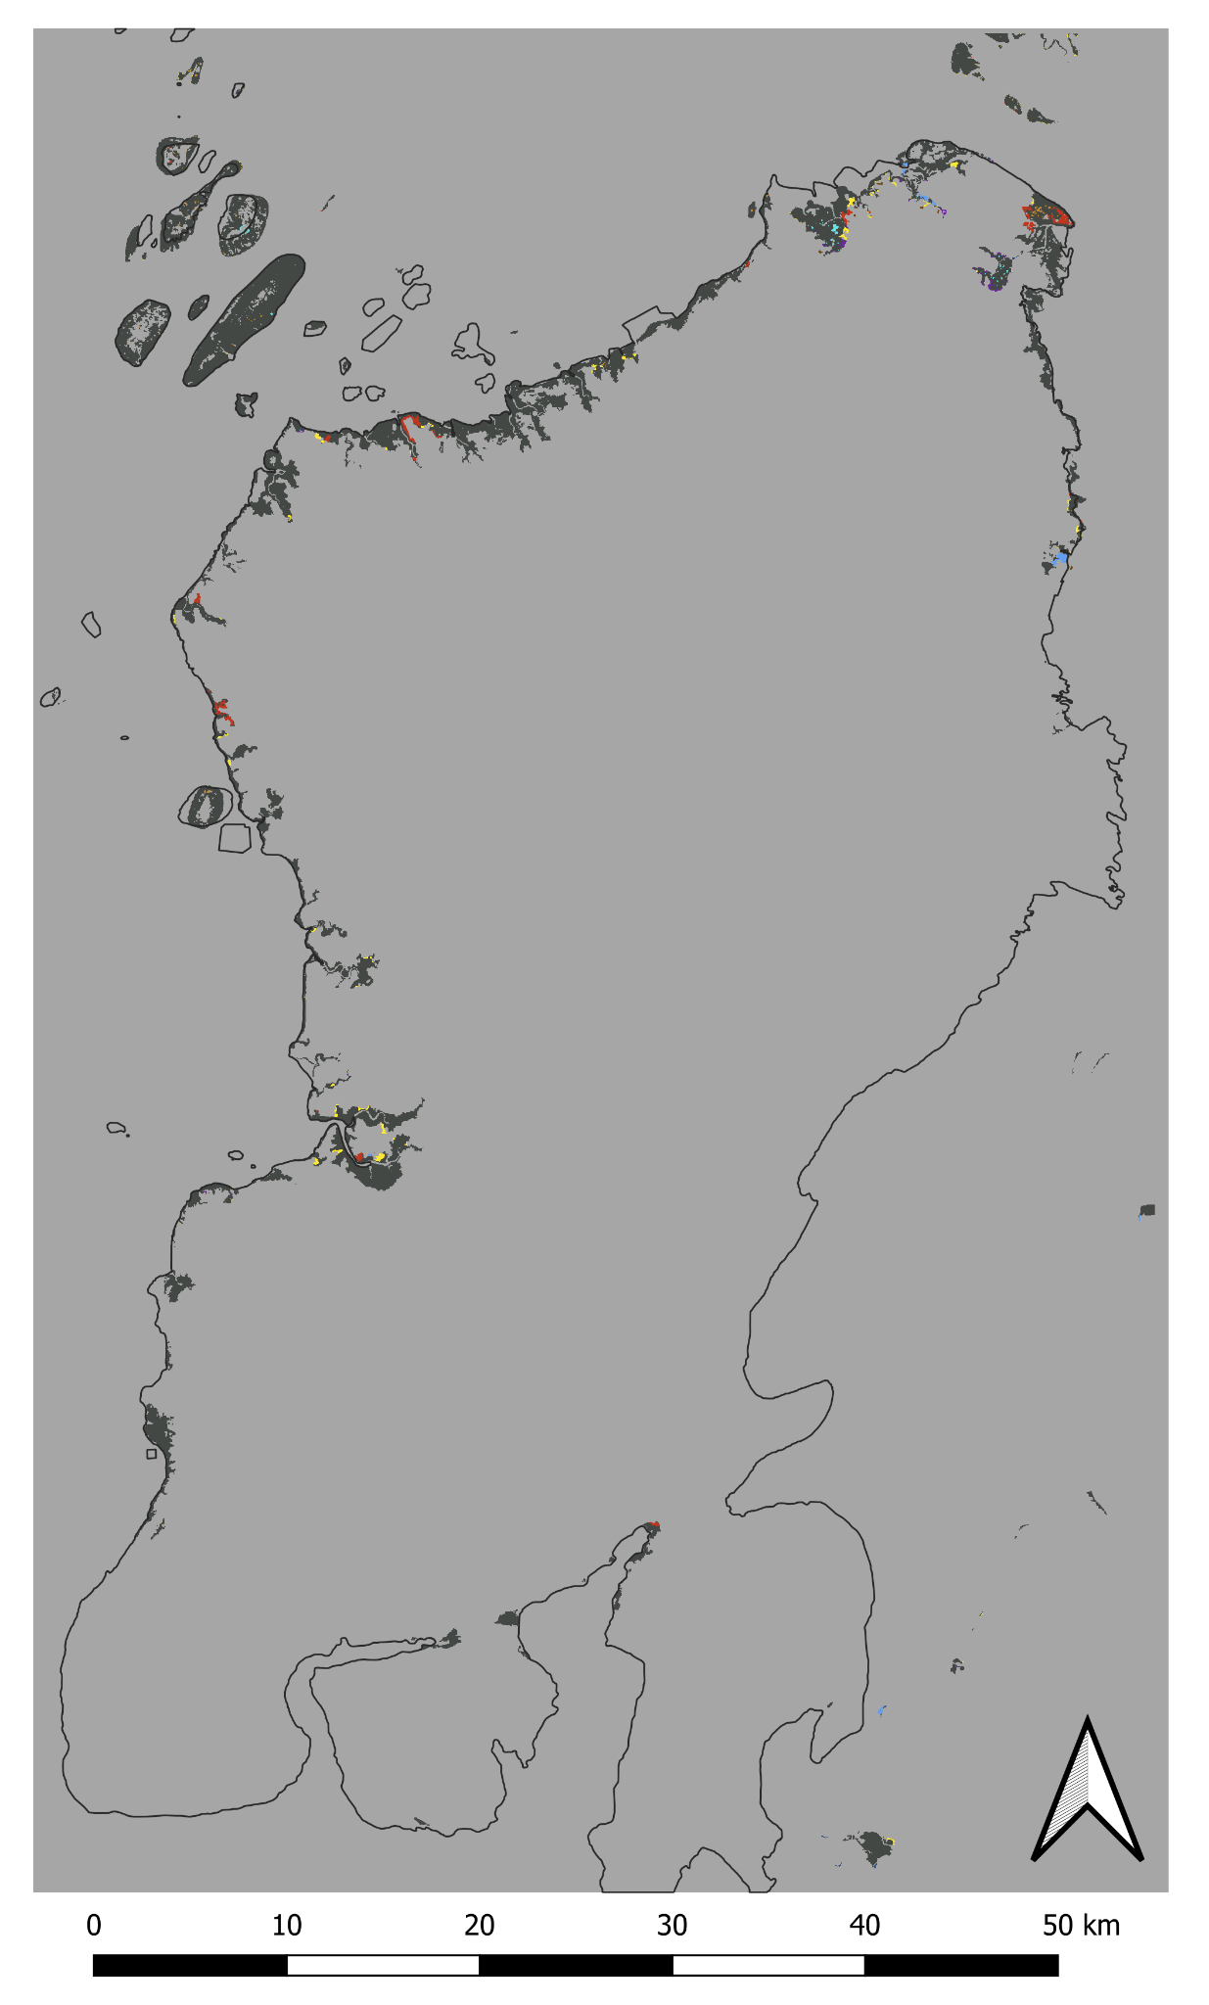
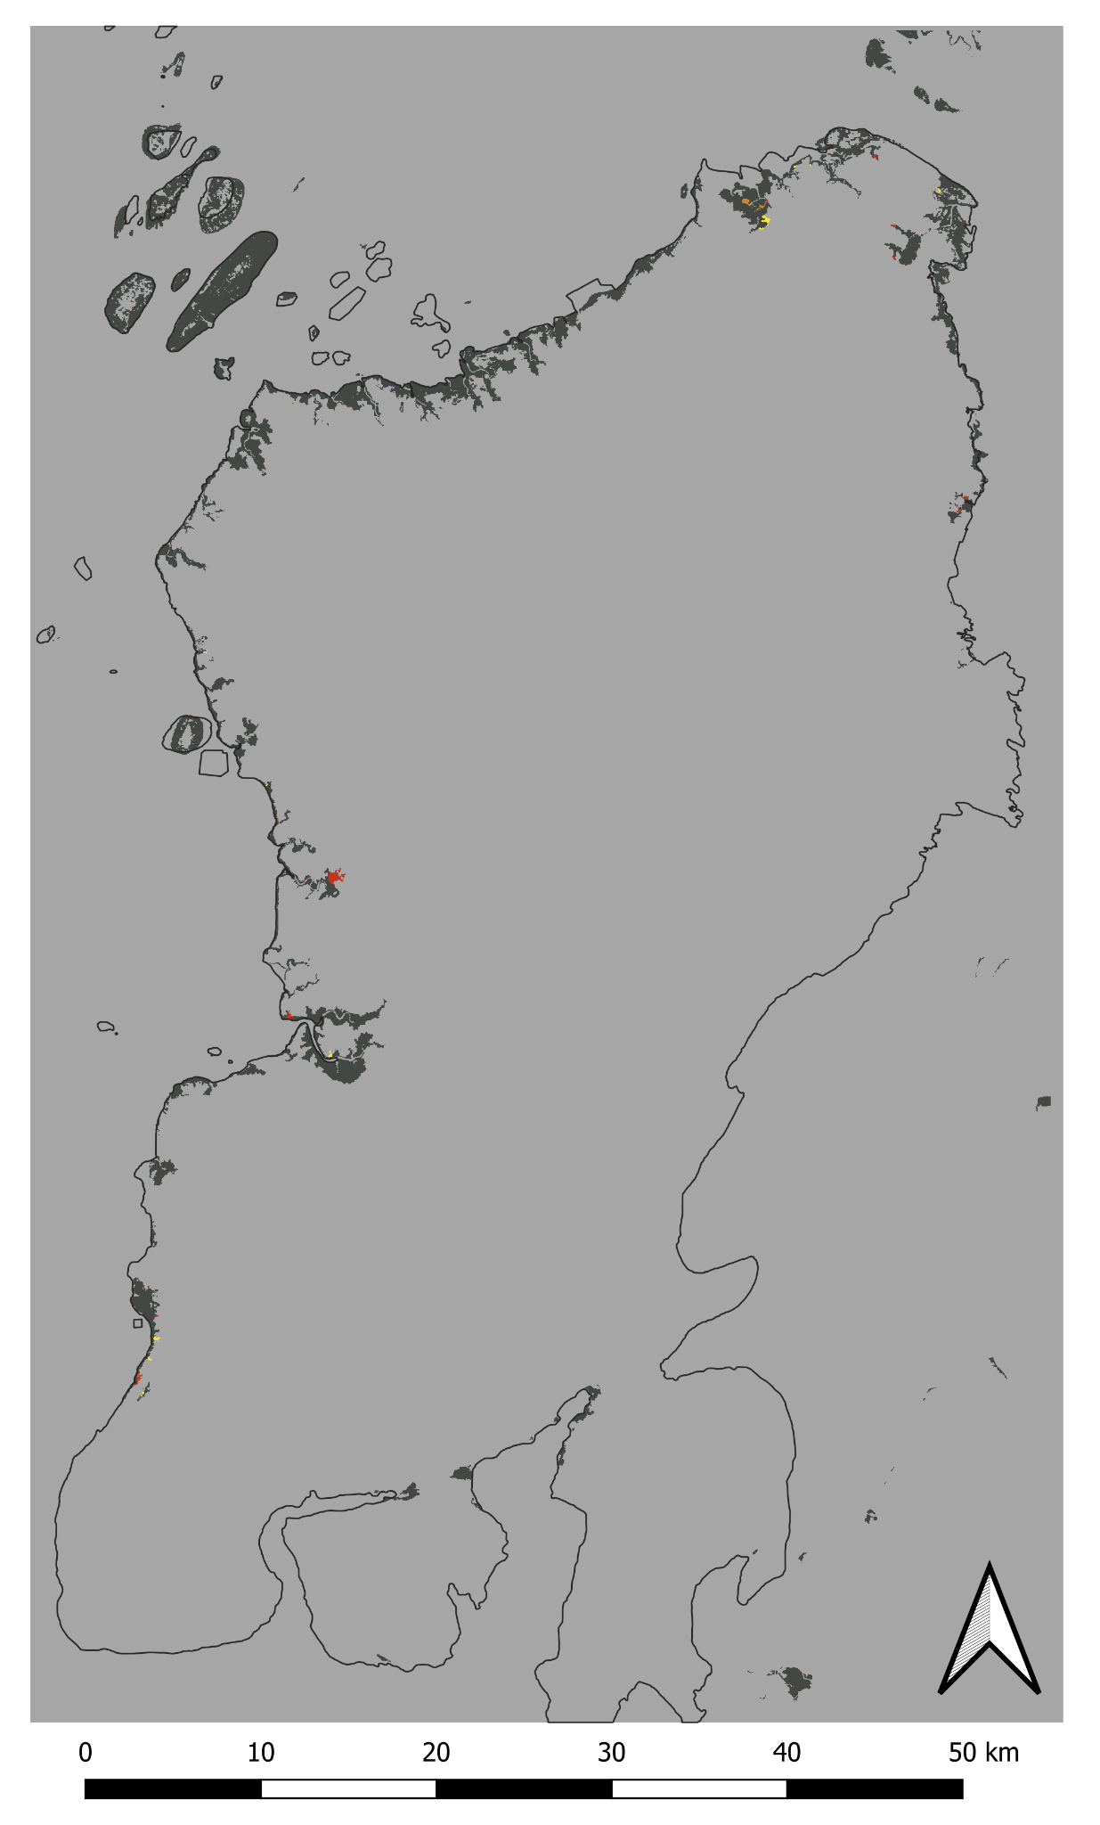
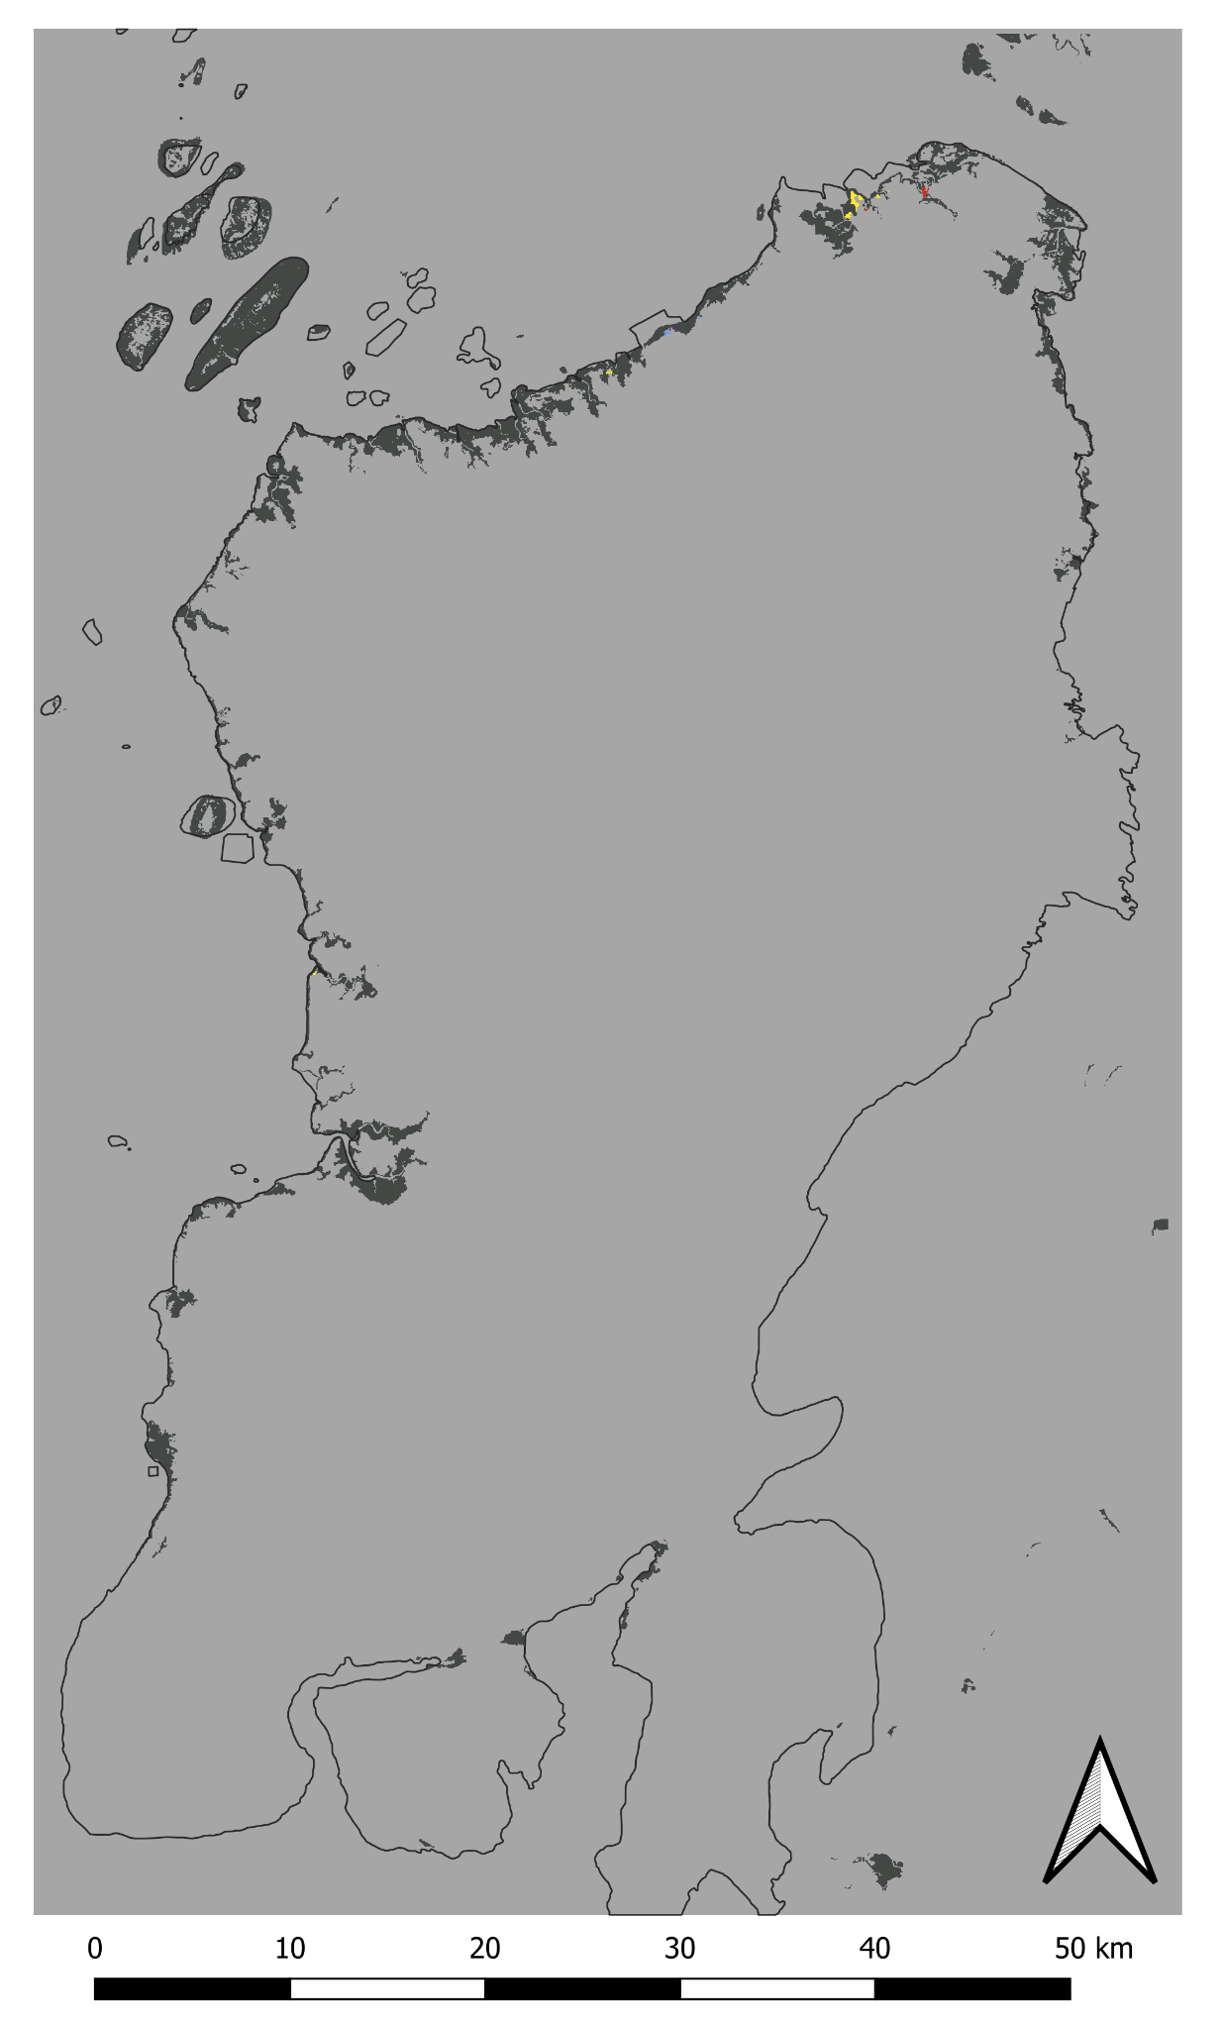
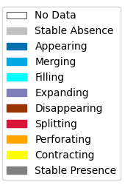
DynamicPATCH - Full Extent
1990-2014 Transition Patterns
2014-2018 Transition Patterns
2018-2020 Transition Patterns
2020-2022 Transition Patterns

Slide 14
DynamicPATCH - Full Extent
1990-2014 Transition Patterns
Patch Type | Value | Pixel Count | Area (km²)
Stable Absence | 0 | 24,624,757 | 5,537.17
Appearing | 1 | 125 | 0.03
Merging | 2 | 8,459 | 1.90
Filling | 3 | 12,264 | 2.76
Expanding | 4 | 2,814 | 0.63
Disappearing | 5 | 1,665 | 0.37
Splitting | 6 | 75,173 | 16.90
Perforating | 7 | 11,210 | 2.52
Contracting | 8 | 41,875 | 9.42
Stable Presence | 9 | 508,722 | 114.39
 | SUM | 25,287,064 | 5,686.10
For this time interval:
All 9 categories defined by DynamicPATCH exist
125 new appearing pixels

Slide 15
DynamicPATCH - Full Extent
2014-2018 Transition Patterns
Patch Type | Value | Pixel Count | Area (km²)
Stable Absence | 0 | 24,747,710 | 5,564.82
Appearing | 1 | 475 | 0.11
Merging | 2 | 2,690 | 0.60
Filling | 3 | 1,574 | 0.35
Expanding | 4 | 2,231 | 0.50
Disappearing | 5 | 633 | 0.14
Splitting | 6 | 9,524 | 2.14
Perforating | 7 | 1,689 | 0.38
Contracting | 8 | 7,907 | 1.78
Stable Presence | 9 | 512,631 | 115.27
 | SUM | 25,287,064 | 5,686.10
For this time interval:
All 9 categories defined by DynamicPATCH exist
475 new appearing pixels

Slide 16
DynamicPATCH - Full Extent
2018-2020 Transition Patterns
Patch Type | Value | Pixel Count | Area (km²)
Stable Absence | 0 | 24,624,757 | 5,569.25
Appearing | 1 | 0 | 0
Merging | 2 | 0 | 0
Filling | 3 | 0 | 0
Expanding | 4 | 74 | 0.02
Disappearing | 5 | 169 | 0.04
Splitting | 6 | 4,028 | 0.91
Perforating | 7 | 826 | 0.19
Contracting | 8 | 1,905 | 0.43
Stable Presence | 9 | 512,673 | 115.28
 | SUM | 25,287,064 | 5,686.10
For this time interval:
Virtually no gain of Mangroves exist in this category
Only 74 expanding pixels

Slide 17
DynamicPATCH - Full Extent
2020-2022 Transition Patterns
Patch Type | Value | Pixel Count | Area (km²)
Stable Absence | 0 | 24,773,837 | 5,570.70
Appearing | 1 | 0 | 0
Merging | 2 | 290 | 0.07
Filling | 3 | 0 | 0
Expanding | 4 | 190 | 0.04
Disappearing | 5 | 20 | 0.00
Splitting | 6 | 557 | 0.13
Perforating | 7 | 2 | 0.00
Contracting | 8 | 1,933 | 0.43
Stable Presence | 9 | 510,235 | 114.73
 | SUM | 25,287,064 | 5,686.10
For this time interval:
There is a small amount of gain for Merging and Expanding categories.
No new appearing pixels

Slide 18
Focus Area 1:
Northeast
We set the focus on a smaller extent within the study area to highlight the transition patches generated by the package.

Slide 19
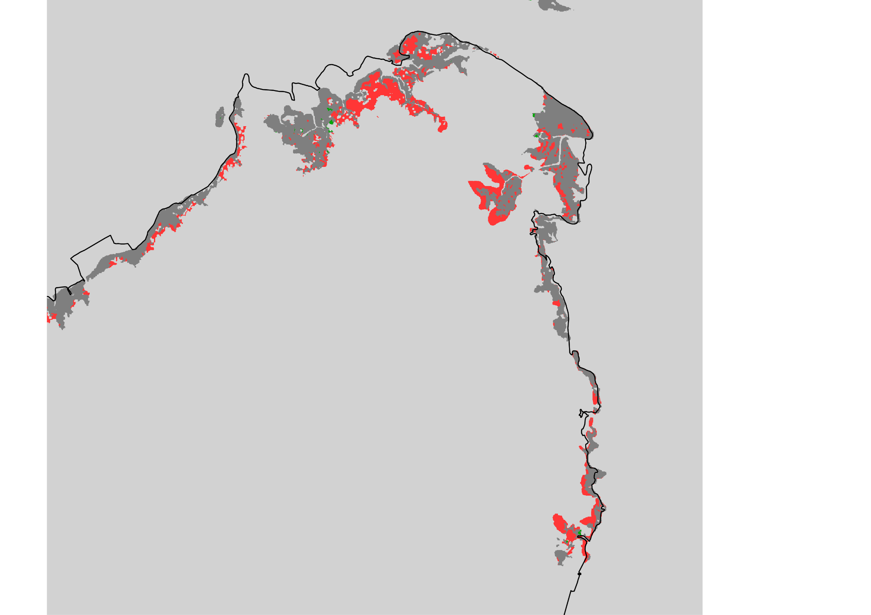
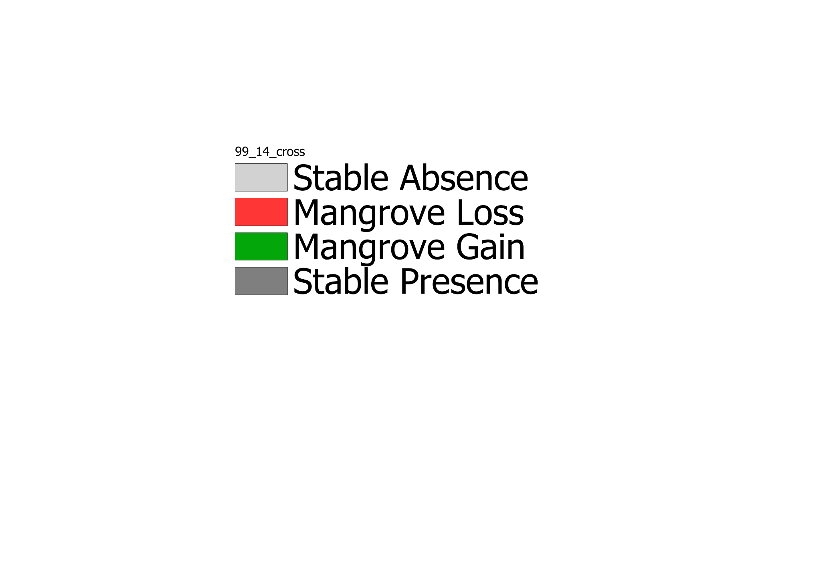
Extent Northeast
1999-2014 Mangrove Change

Slide 20
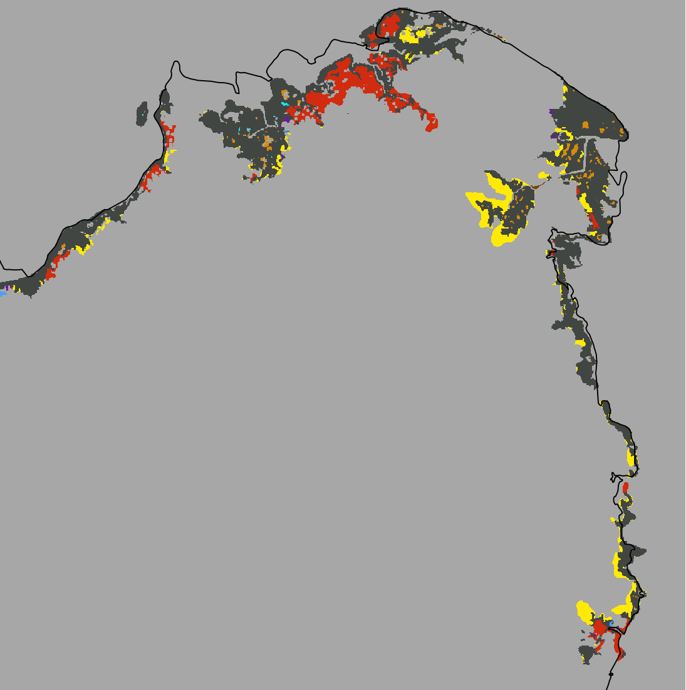
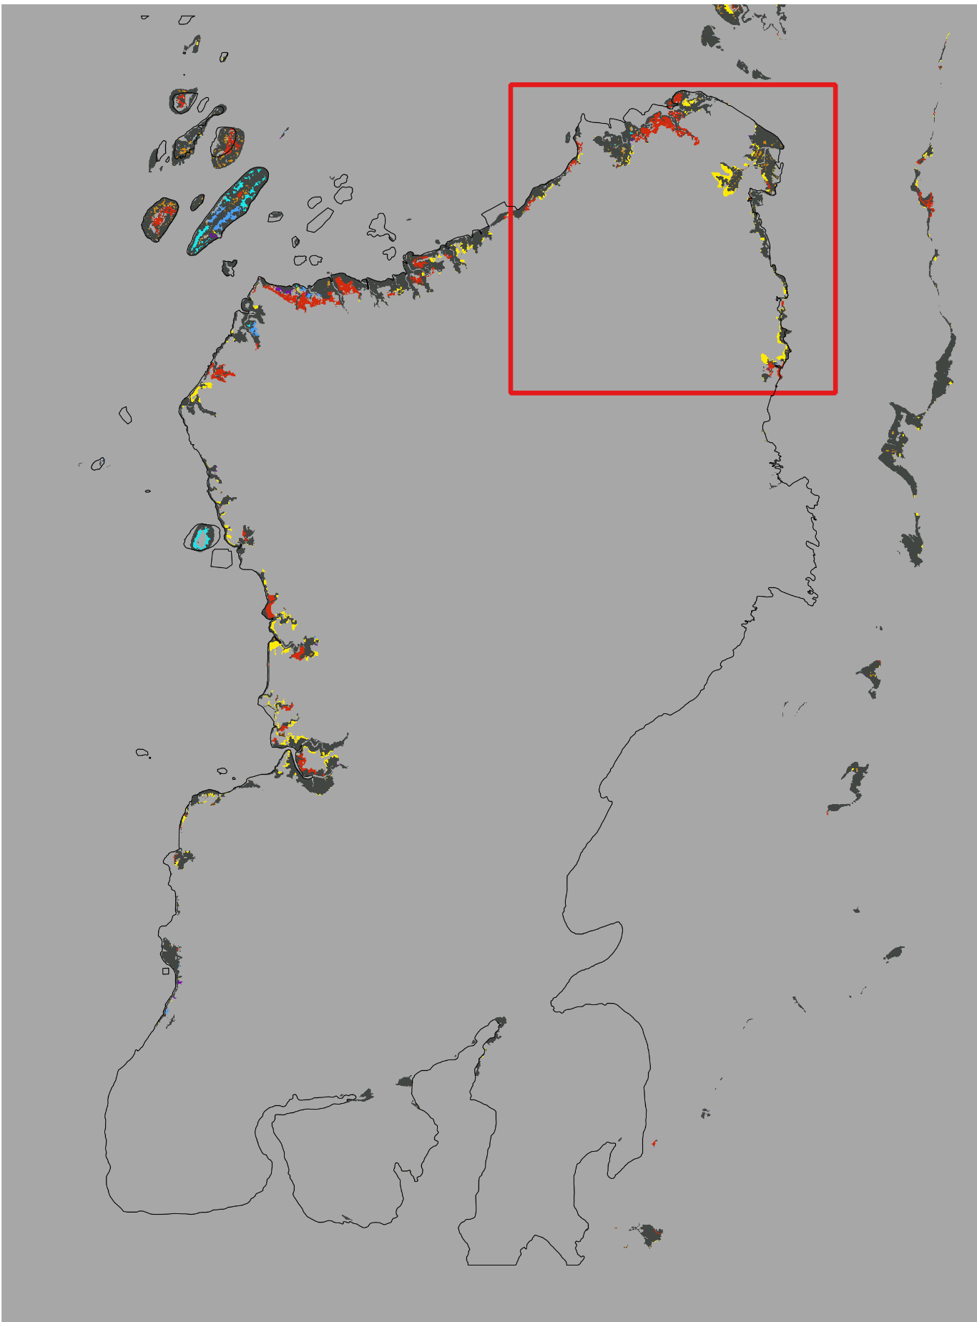
DynamicPATCH - Northeast
1999-2014 Transition Patterns
Connectivity = 8

Slide 21
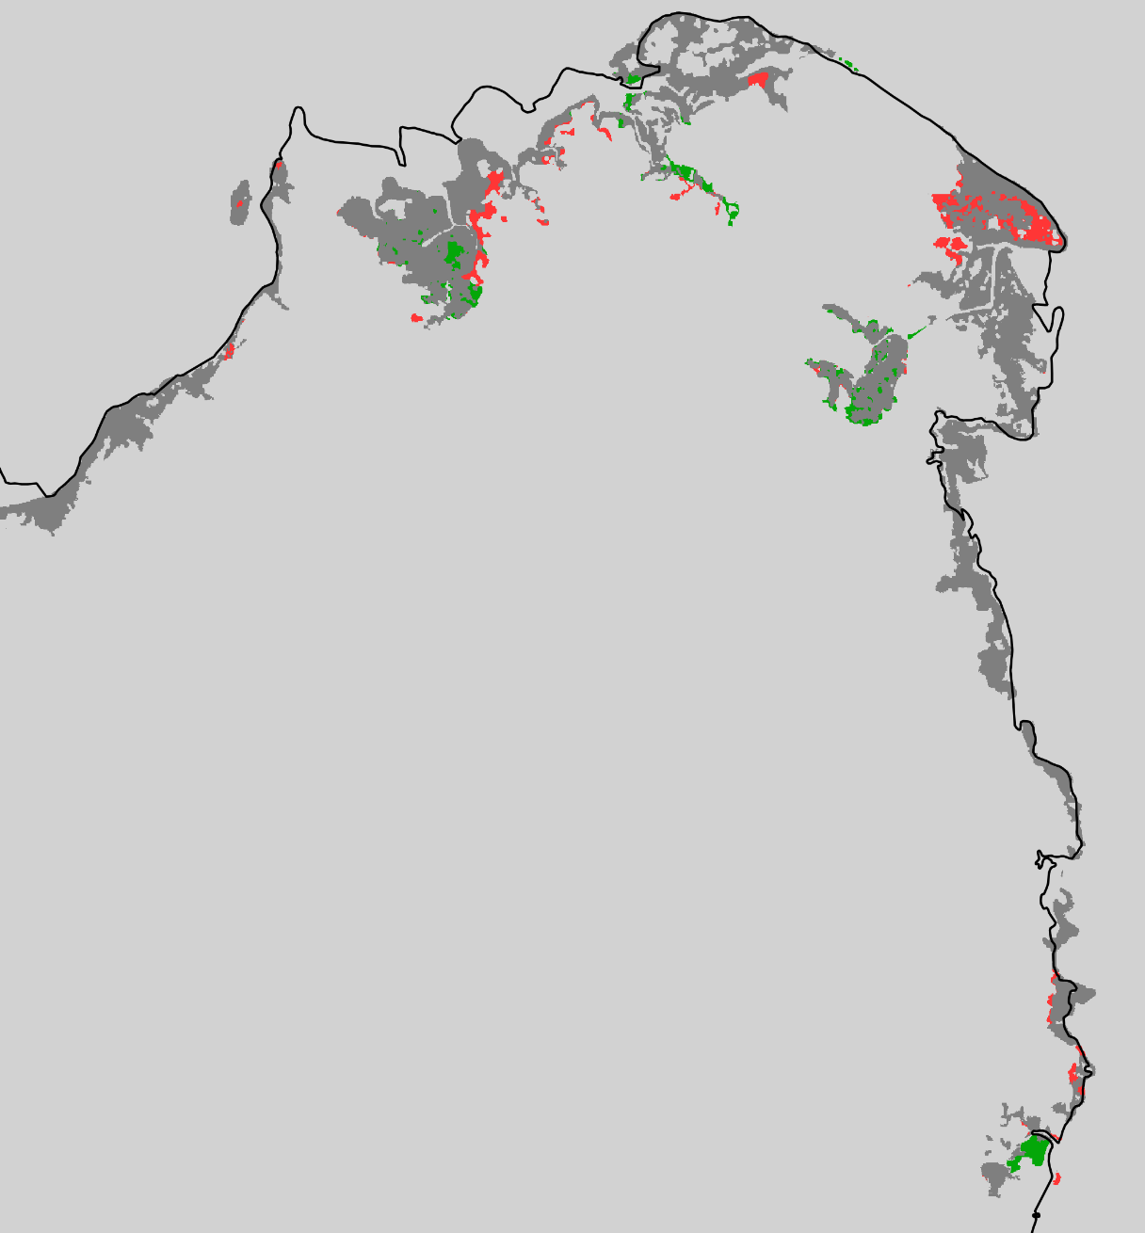
Extent Northeast
2014-2018 Mangrove Change

Slide 22
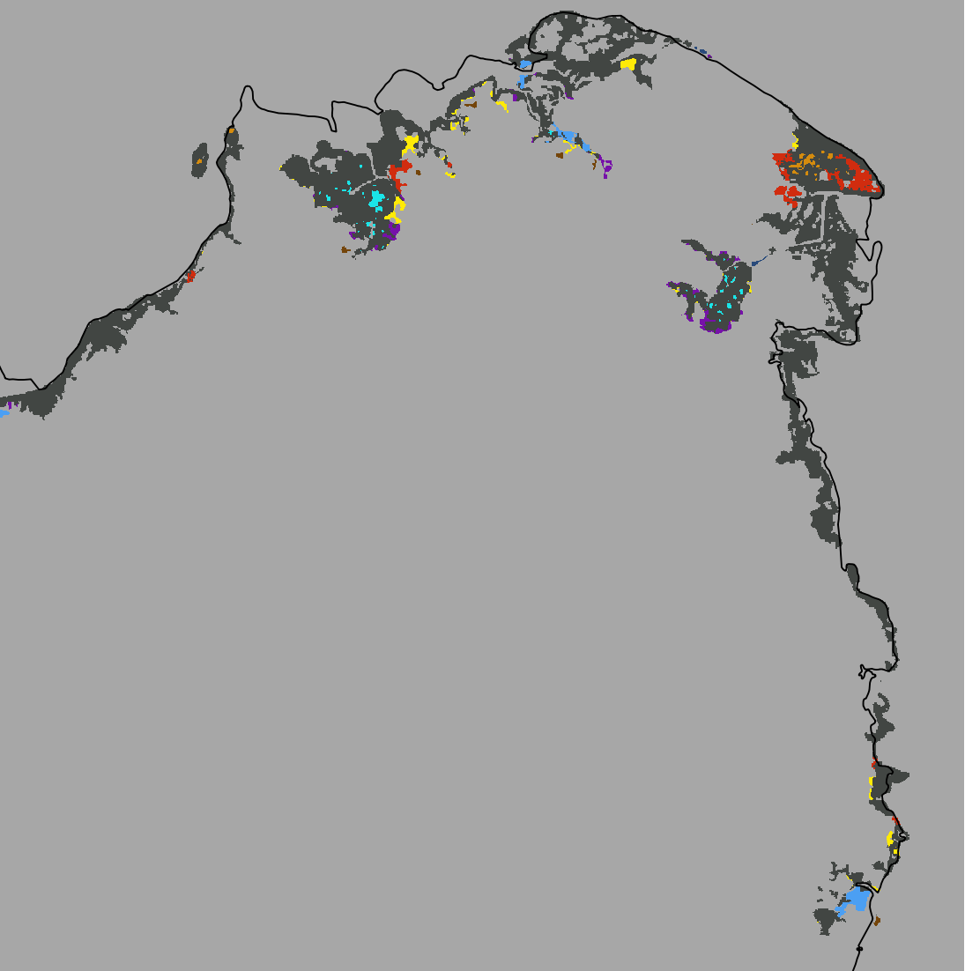
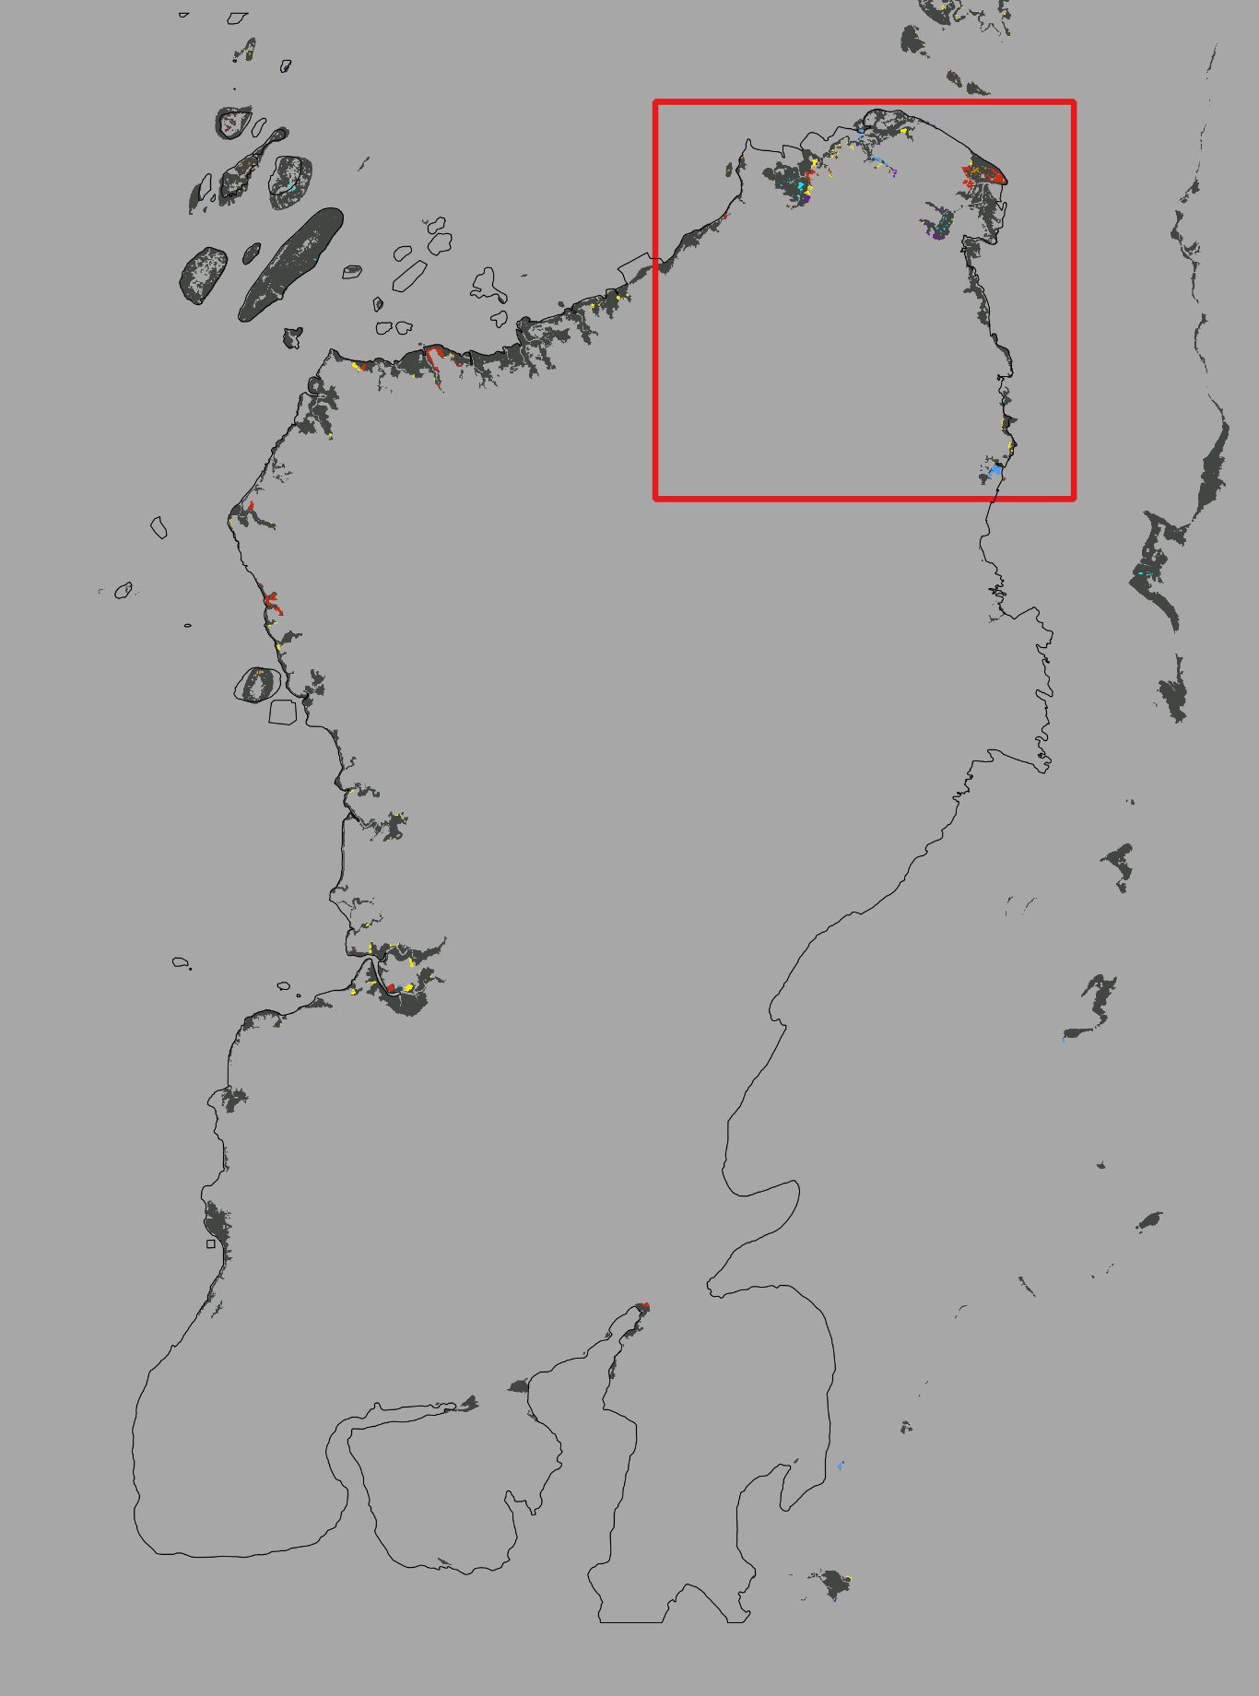
DynamicPATCH - Northeast
2014-2018 Transition Patterns
Connectivity = 8

Slide 23
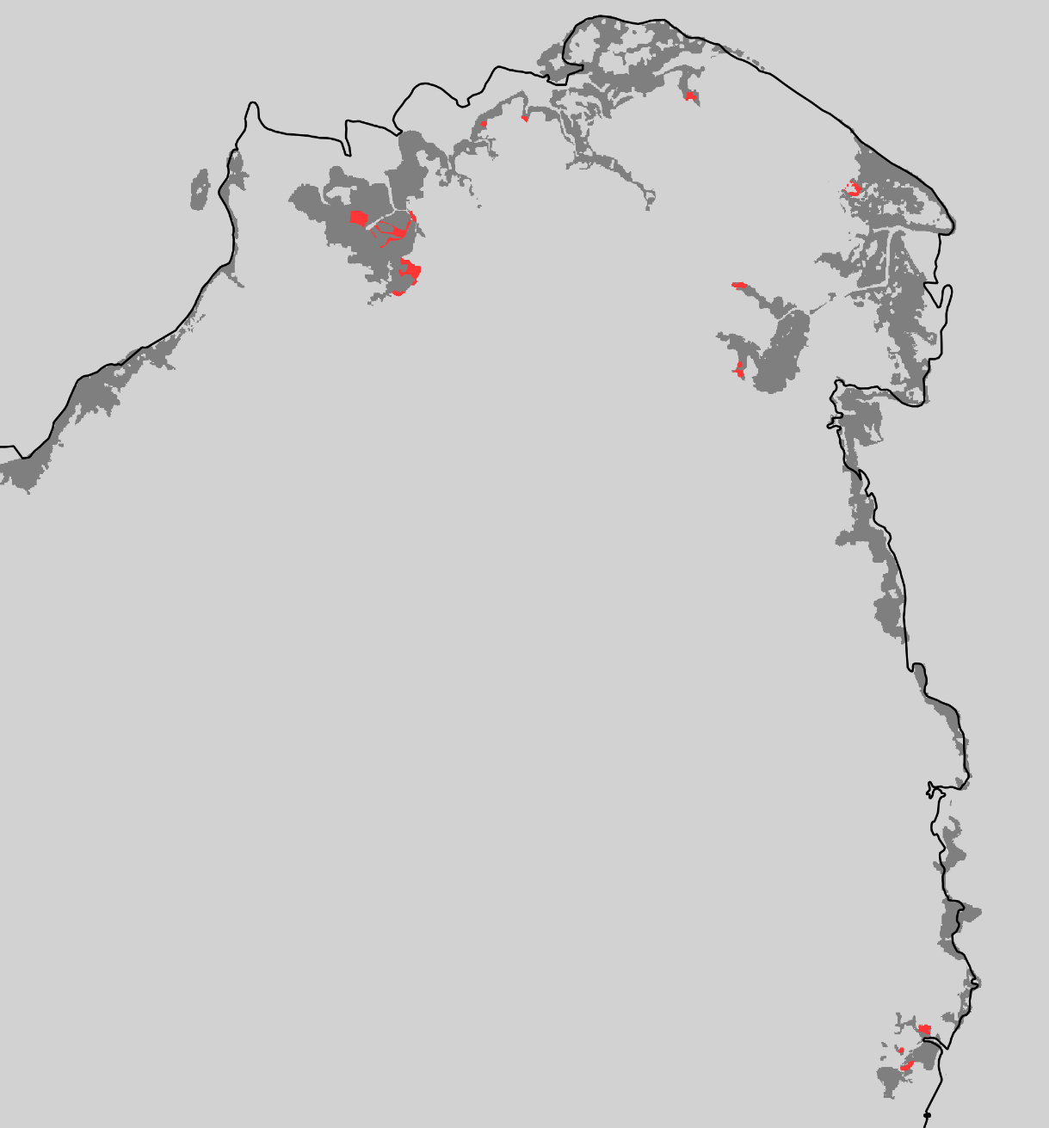
Extent Northeast
2018-2020 Mangrove Change

Slide 24
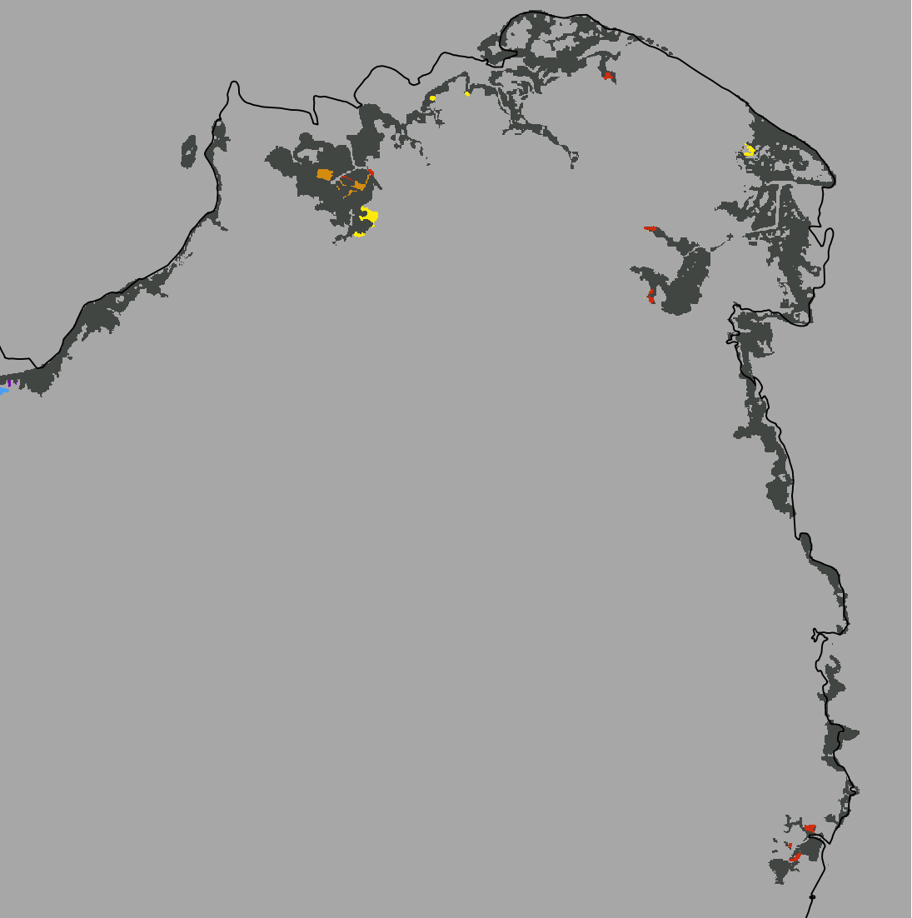

DynamicPATCH - Northeast
2018-2020 Transition Patterns
Connectivity = 8

Slide 25
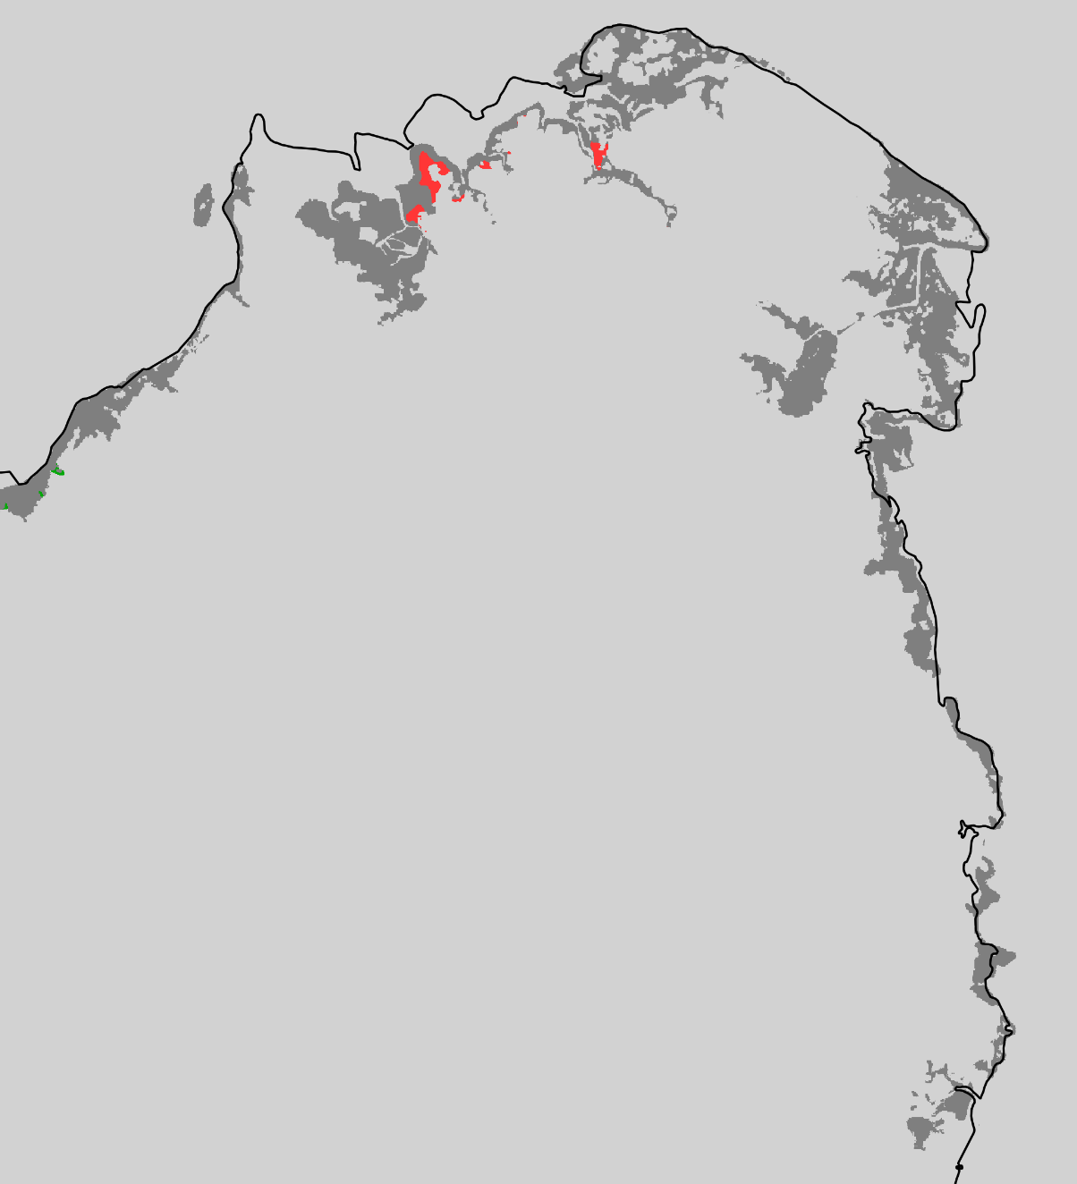
Extent Northeast
2020-2022 Mangrove Change

Slide 26
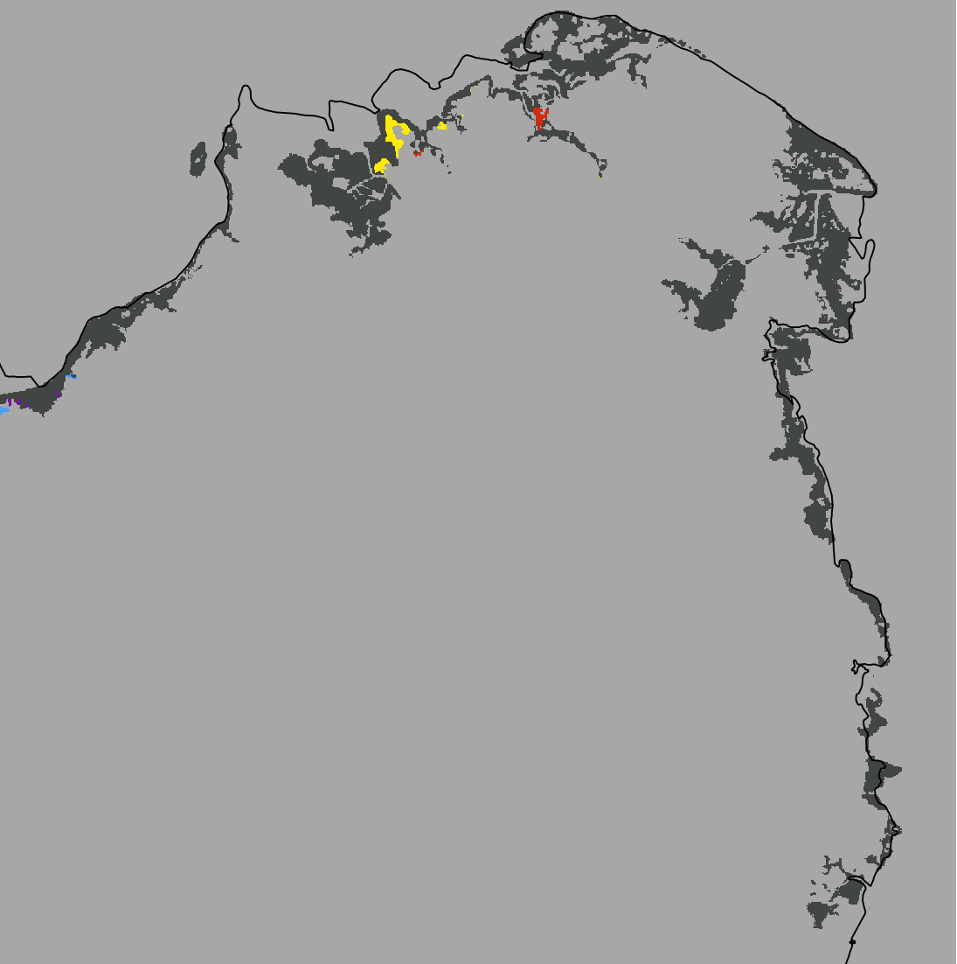

DynamicPATCH - Northeast
2020-2022 Transition Patterns
Connectivity = 8

Slide 27
Focus Area 1:
Northwest
We set the focus on a smaller extent within the study area to highlight the transition patches generated by the package.

Slide 28
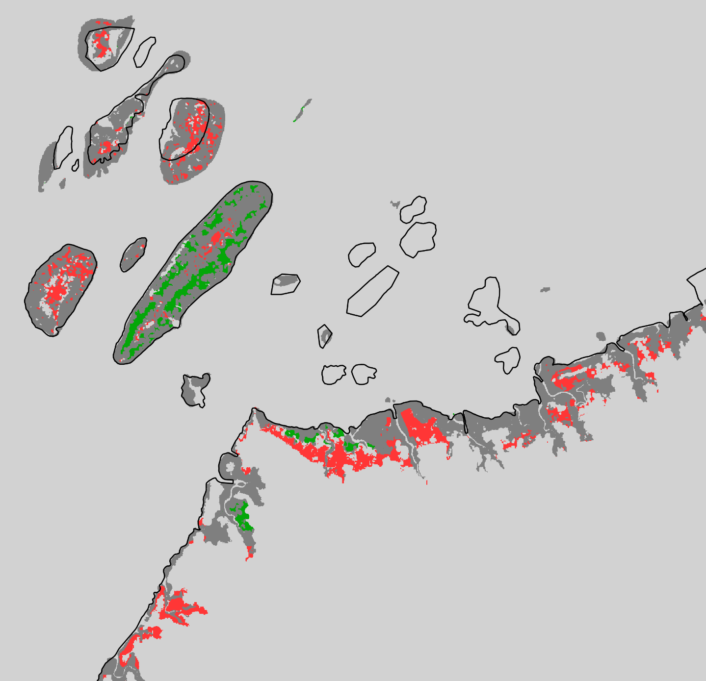
Extent Northwest
1999-2014 Mangrove Change

Slide 29
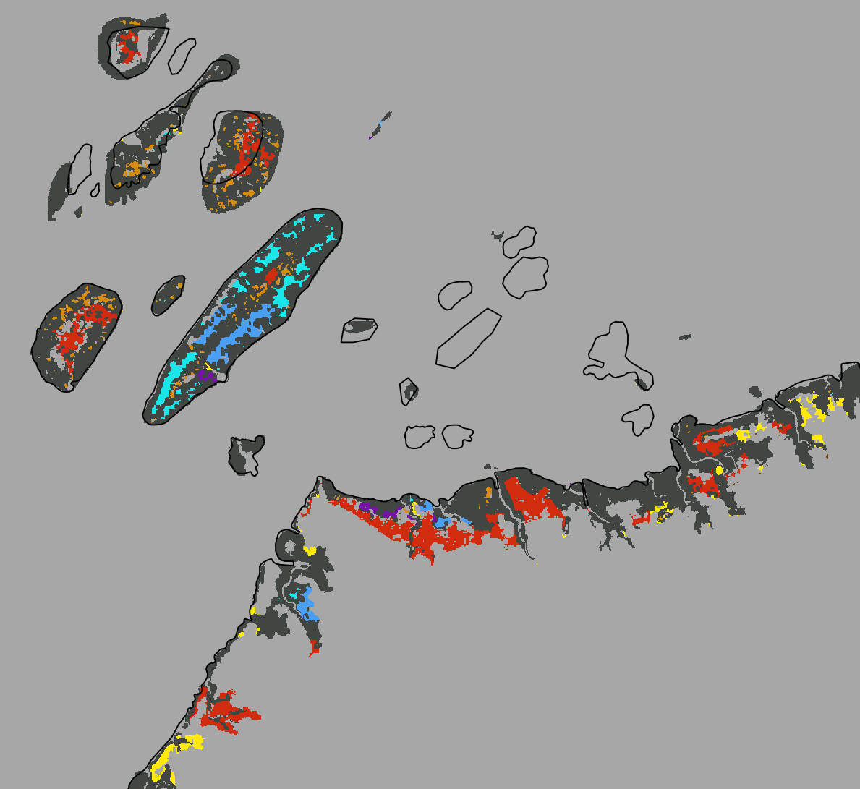
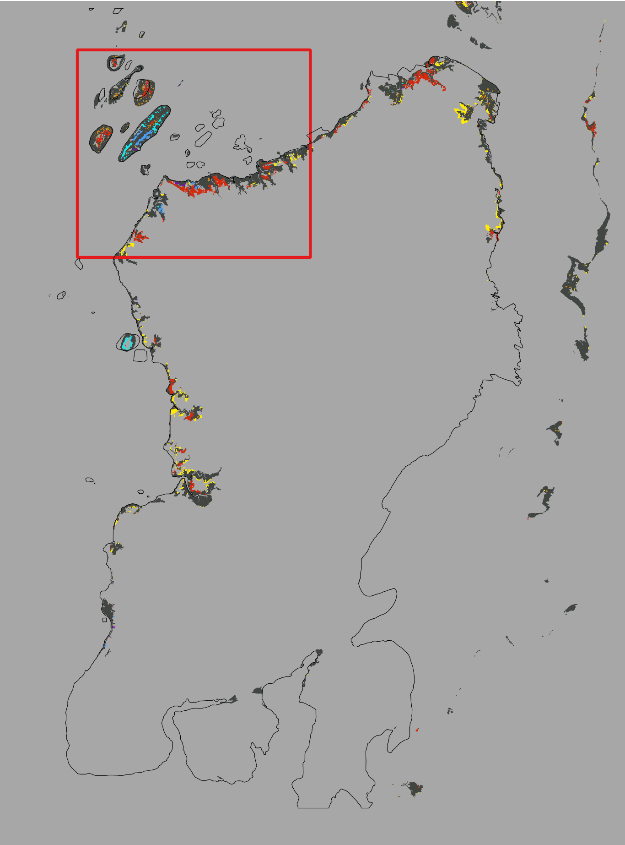
DynamicPATCH - Northwest
1999-2014 Transition Patterns
Connectivity = 8

Slide 30
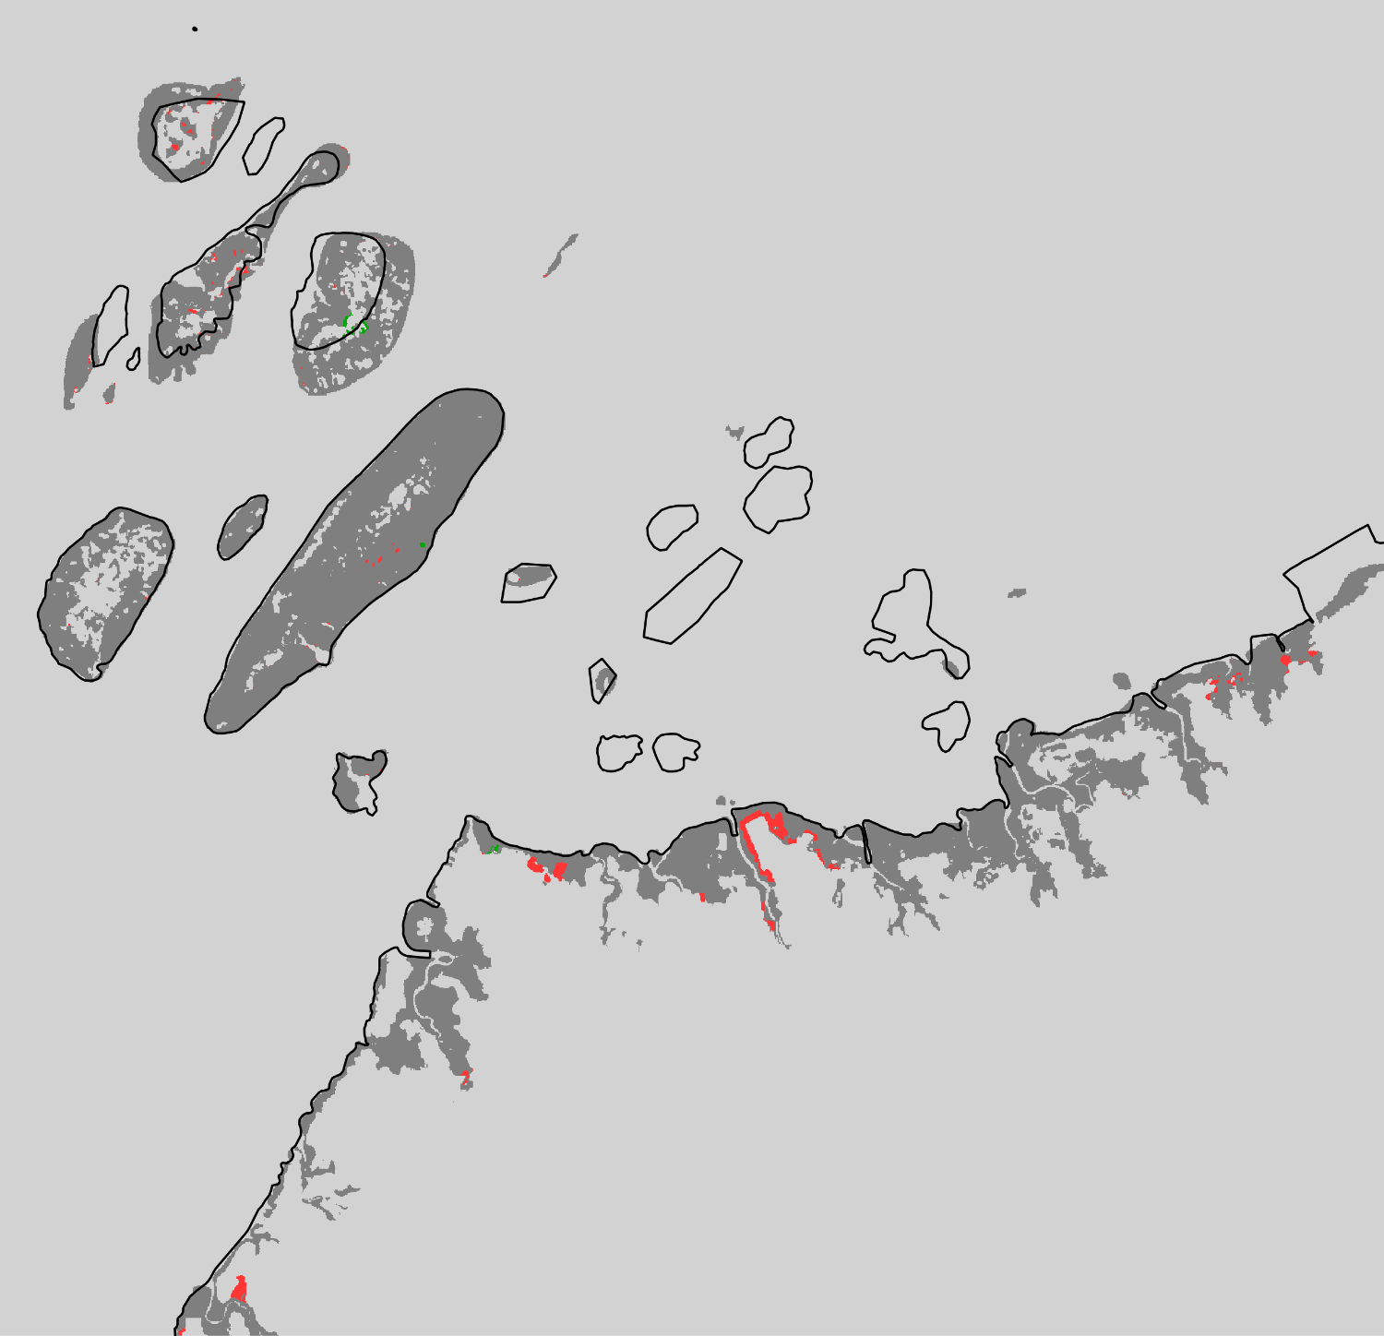
Extent Northwest
2014-2018 Mangrove Change

Slide 31
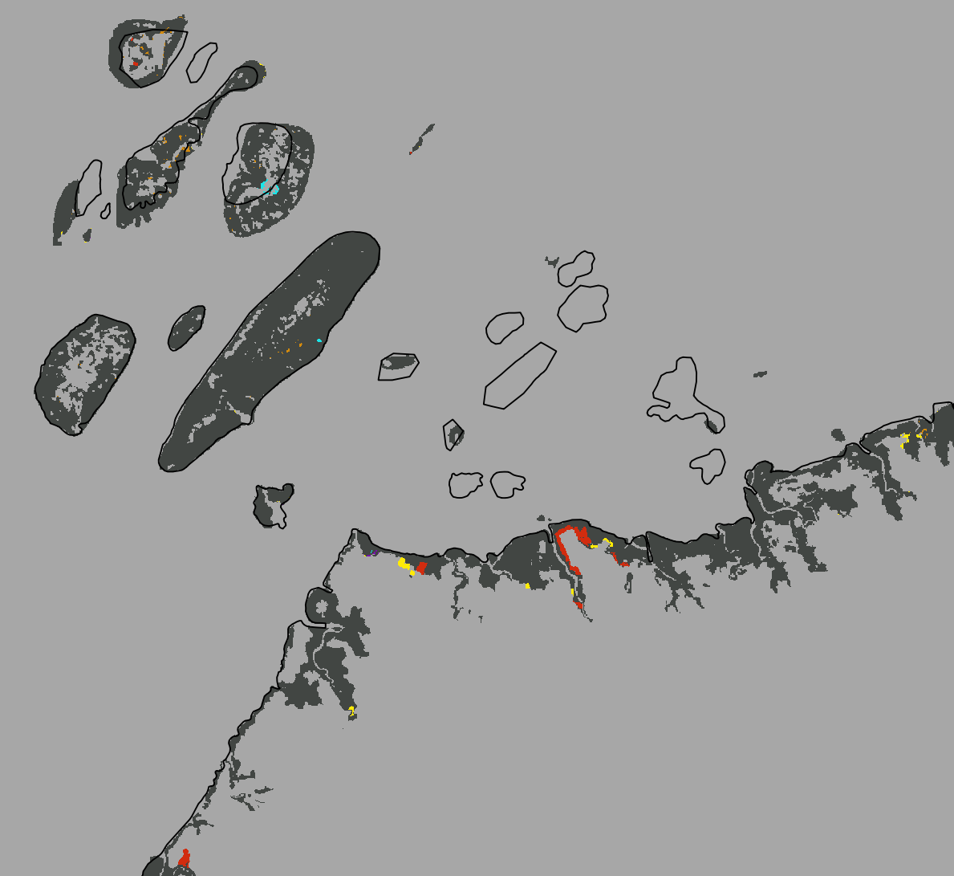
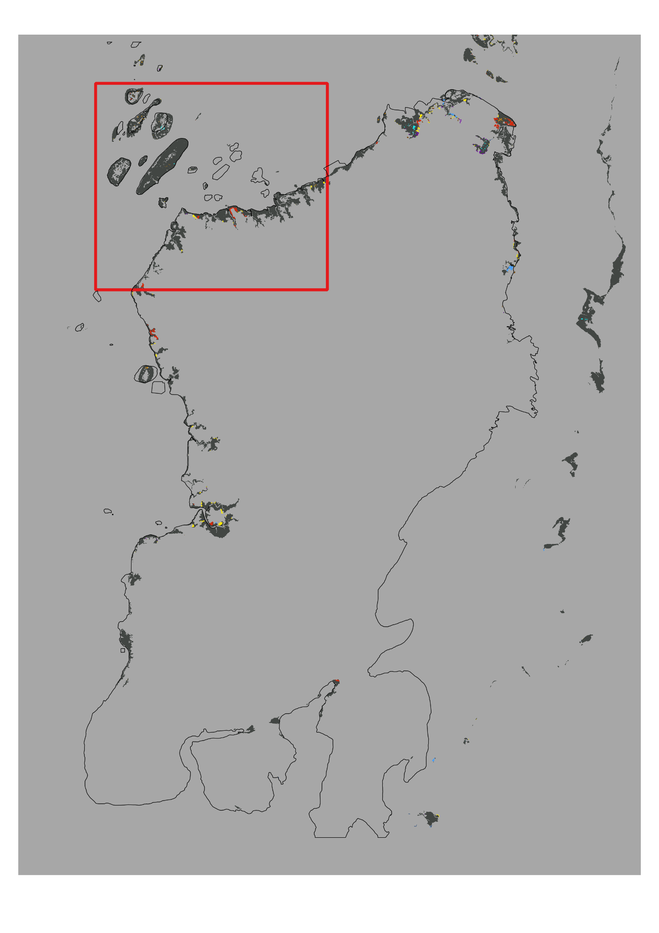
DynamicPATCH - Northwest
2014-2018 Transition Patterns
Connectivity = 8

Slide 32
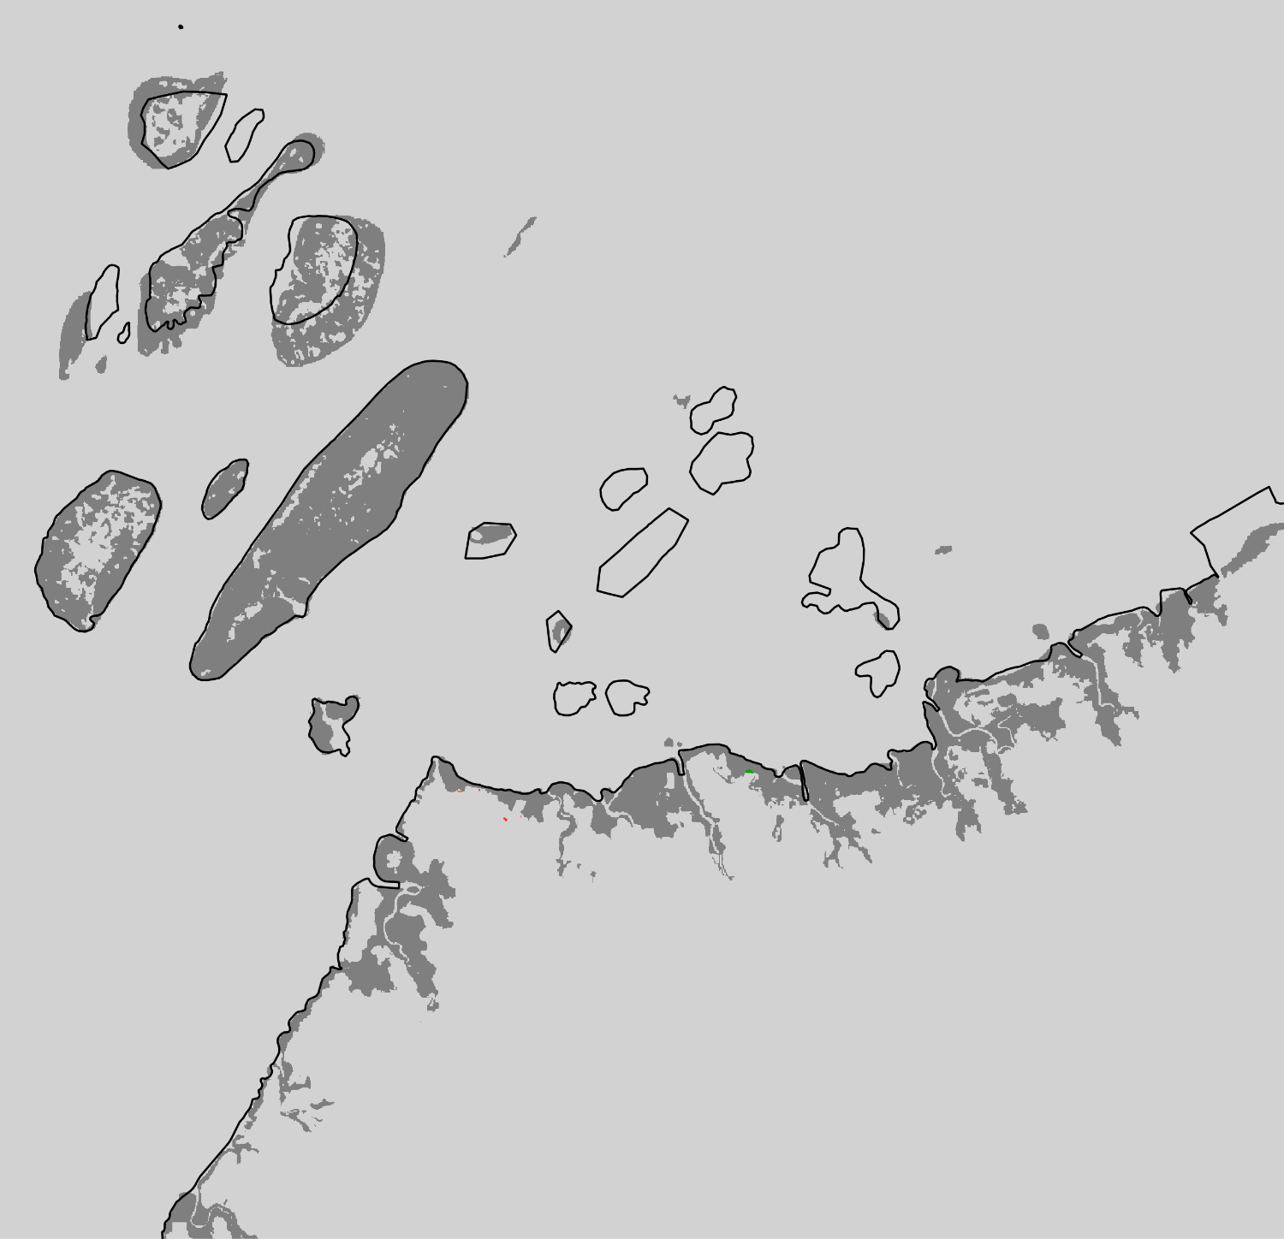
Extent Northwest
2018-2020 Mangrove Change

Slide 33
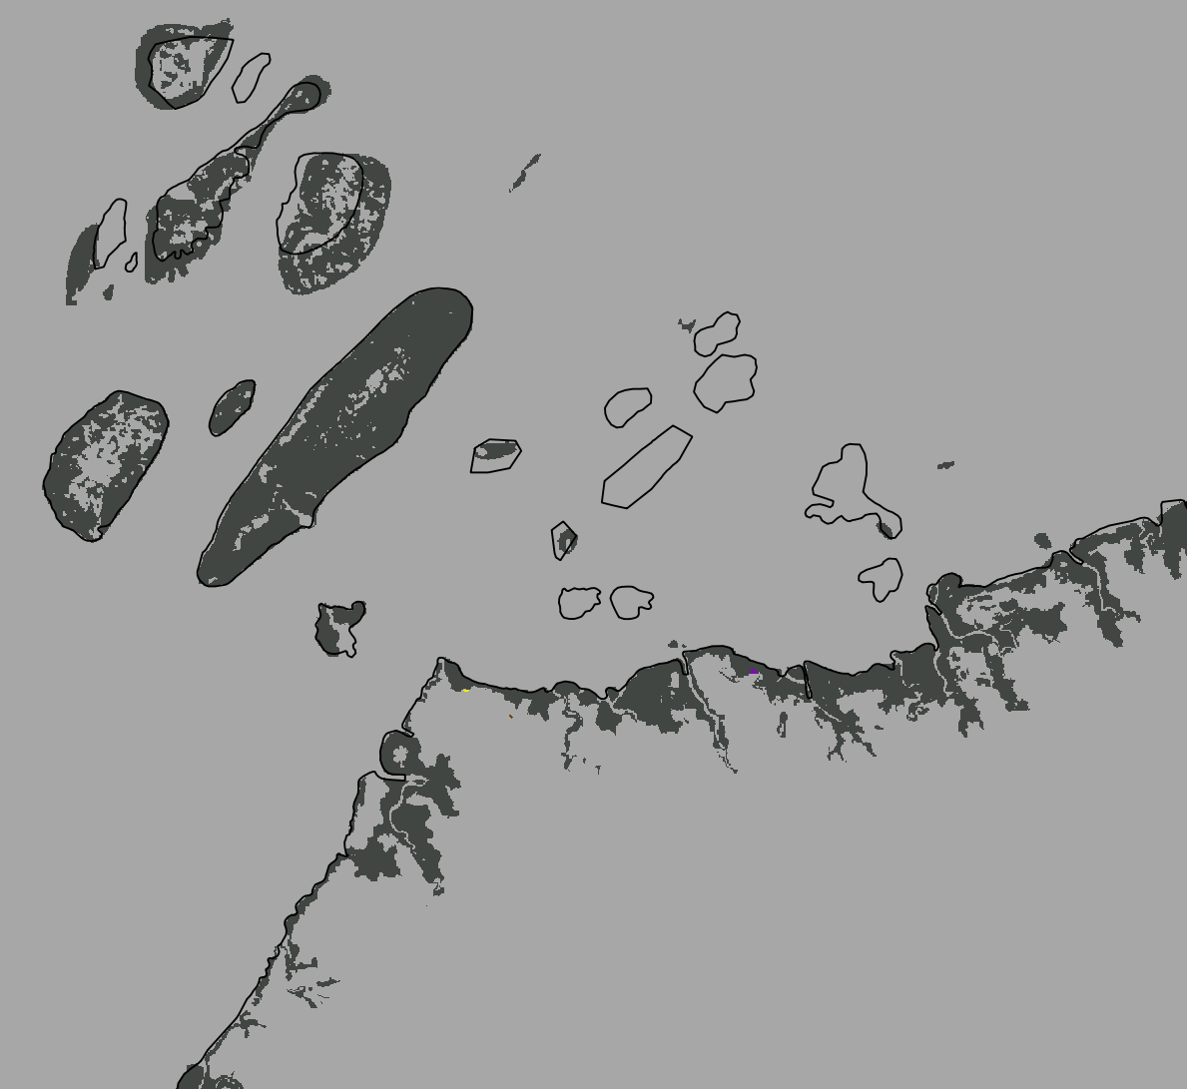

DynamicPATCH - Northwest
2018-2020 Transition Patterns
Connectivity = 8

Slide 34
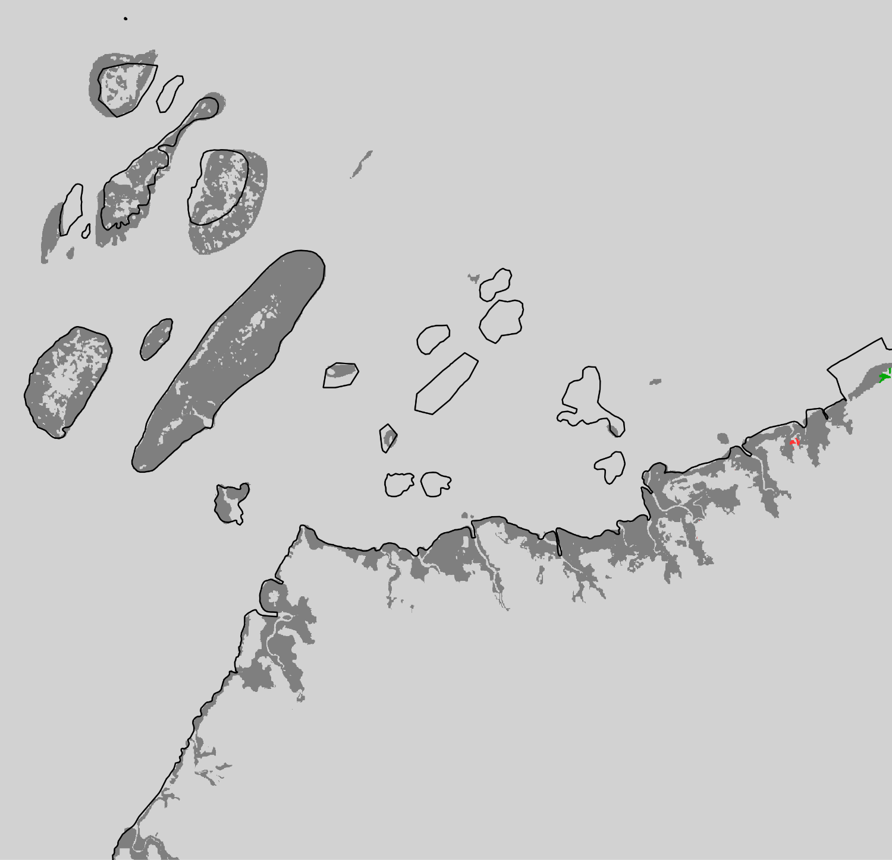
Extent Northwest
2020-2022 Mangrove Change

Slide 35
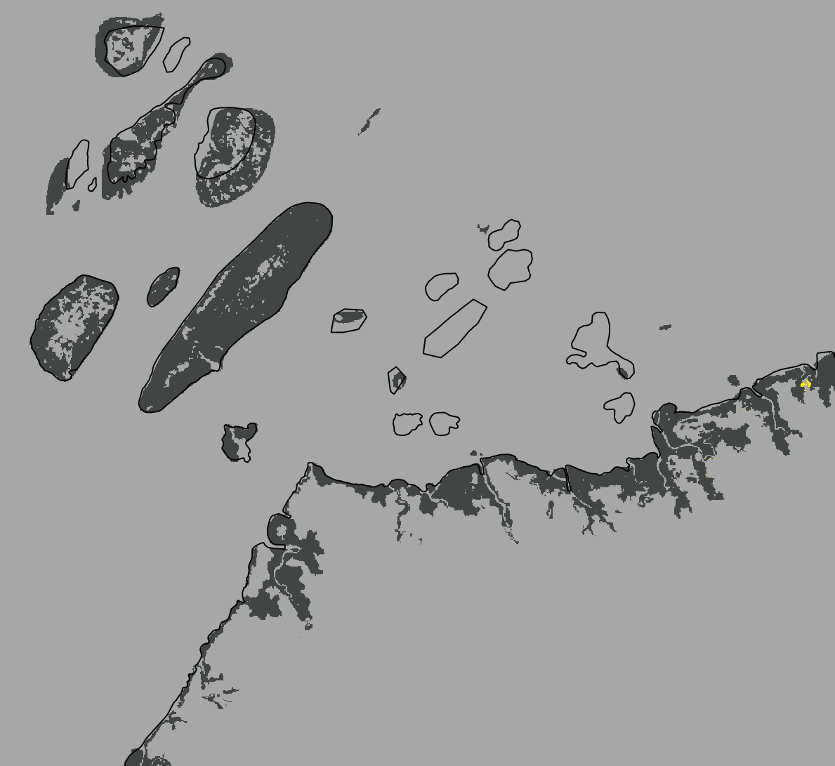

DynamicPATCH - Northwest
2020-2022 Transition Patterns
Connectivity = 8

Slide 36
Mangrove Change Over the Entire Spatial and Temporal Extent
Patch Type | Pixel Count | Area (km2)
Appearing | 600 | 0.14
Merging | 11,439 | 2.57
Filling | 13,838 | 3.11
Expanding | 5,309 | 1.19
Disappearing | 2,487 | 0.55
Splitting | 89,282 | 20.08
Perforating | 13,727 | 3.09
Contracting | 53,620 | 12.06
Gross Gain | 31,186 | 7.01
Gross Loss | 159,116 | 35.78
Net Change | -127,930 | -28.77

Slide 37
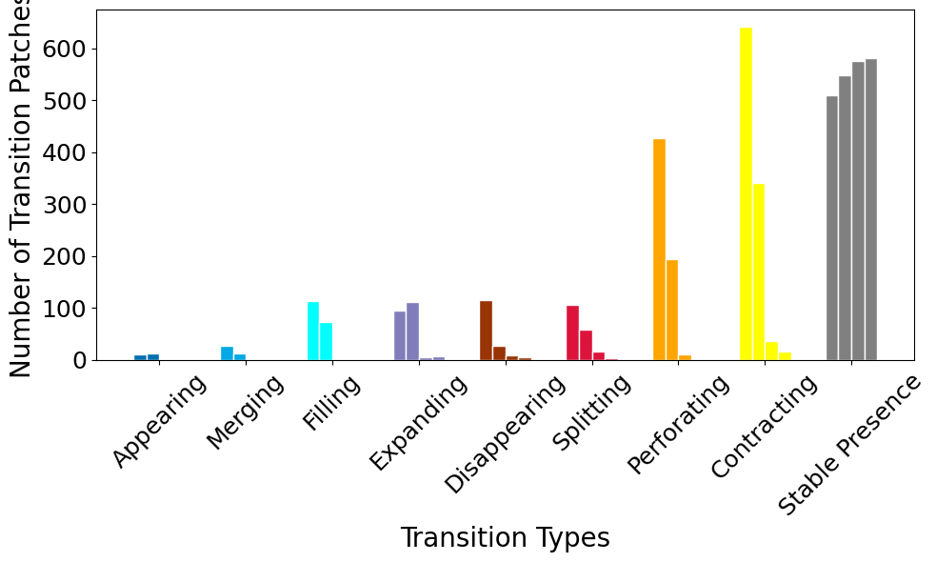
Results from DynamicPATCH (Connectivity 4, Full Extent)
A high number of contracting patches, especially from 1999-2014, indicates loss within patches of stable presence.
Number of Transition Patches for Each Transition Type
A high number of perforating patches, also from 1999-2014 and 2014-2018, indicates “gaps” of absence within patches of presence are increasing. This however does not change the overall number of patches.
Each bar represents a time interval

Slide 38
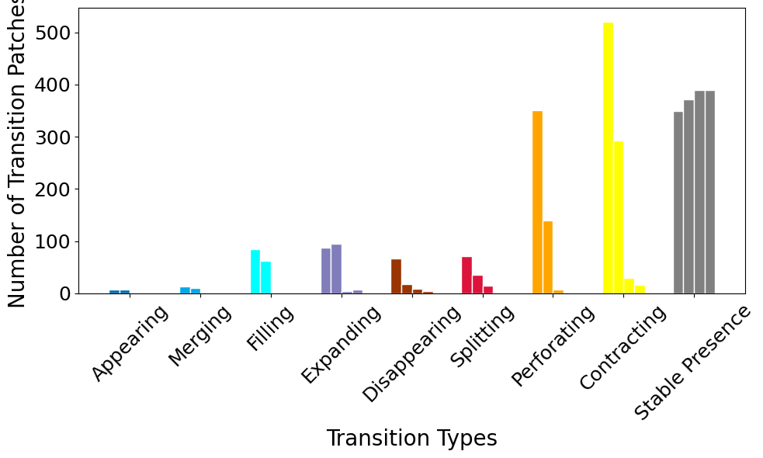
Results from DynamicPATCH (Connectivity 8, Full Extent)
A high number of contracting patches, especially from 1999-2014, indicates loss within patches of stable presence.
Number of Transition Patches for Each Transition Type
A high number of perforating patches, also from 1999-2014 and 2014-2018, indicates “gaps” of absence within patches of presence are increasing. This however does not change the overall number of patches.
Each bar represents a time interval

Slide 39
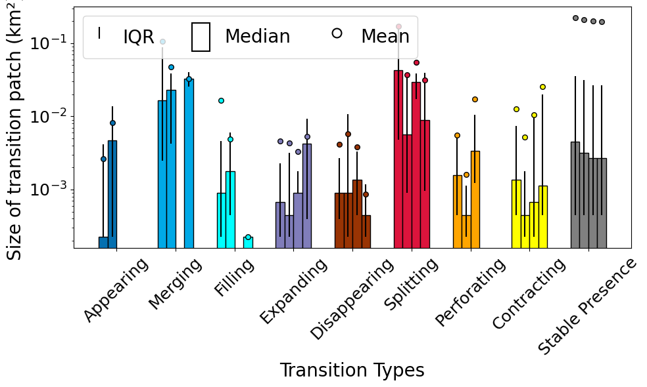
Results from DynamicPATCH (Connectivity 4, Full Extent)
Distribution of Transition
Patch Sizes
On average, transition patches that experience splitting as a transition type are largest

Slide 40
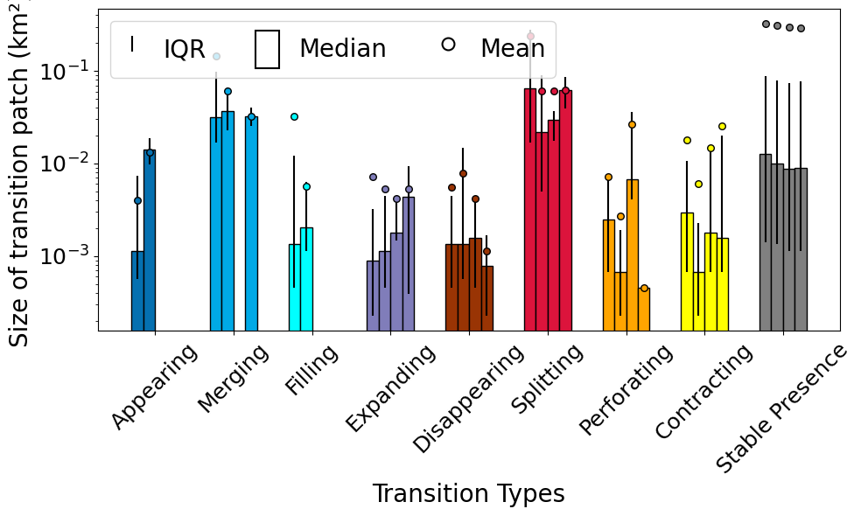
Results from DynamicPATCH (Connectivity 8, Full Extent)
Distribution of Transition
Patch Sizes
On average, transition patches that experience splitting as a transition type are largest

Slide 41
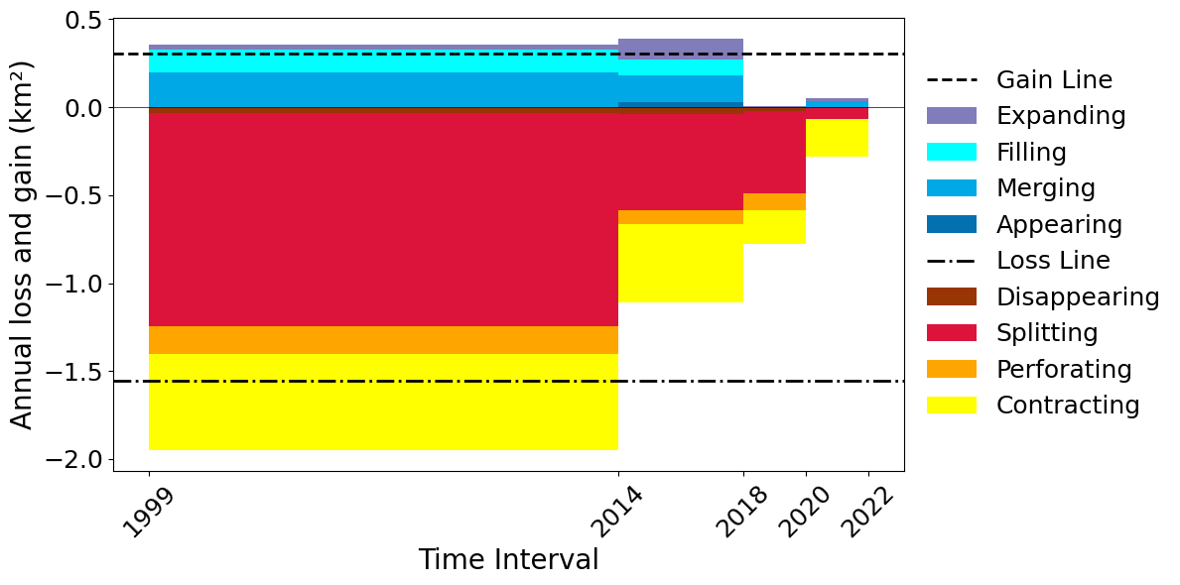
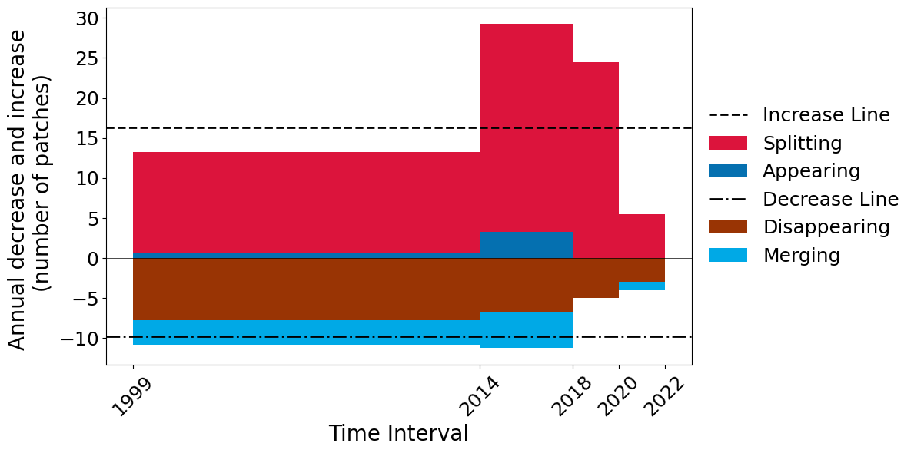
Results from DynamicPATCH (Connectivity 4, Full Extent)
Annual Gross Loss and Gross Gain by Transition Types
Annual Gross Increase and Decrease in Number of Patches
Possible impacts: Splitting, perforating and contracting of patches promotes habitat fragmentation in mangrove ecosystems, even if net loss is low
→ edge effects
→ potential threat to ecosystem (Bryan-Brown, Dale N., et al. (2020))

Slide 42
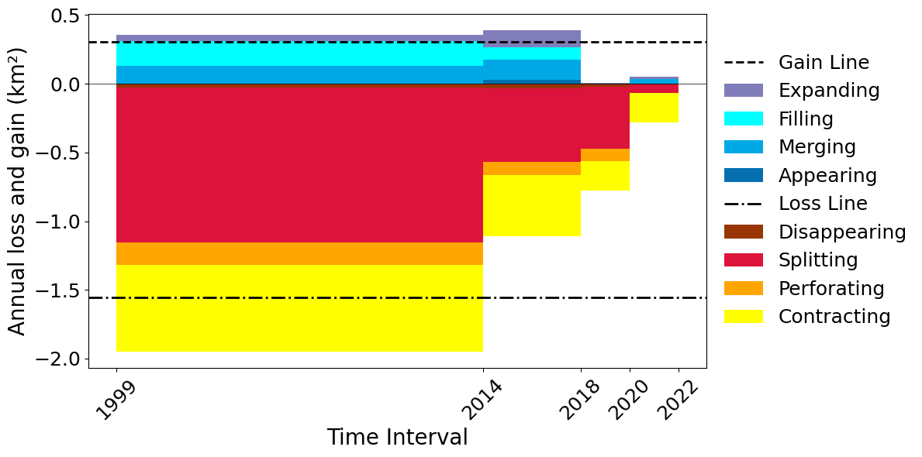
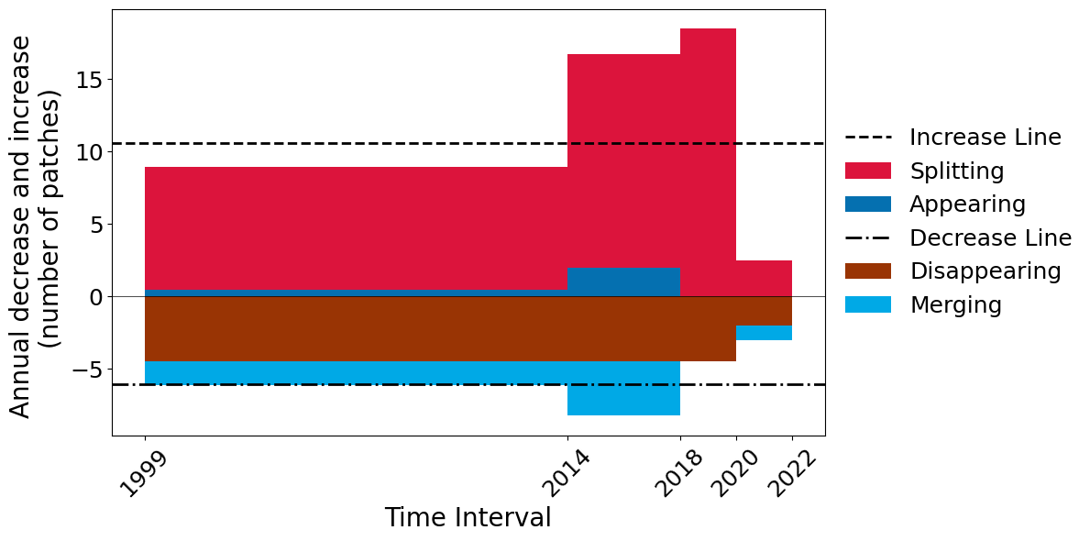
Results from DynamicPATCH (Connectivity 8, Full Extent)
Annual Gross Loss and Gross Gain by Transition Types
Annual Gross Increase and Decrease in Number of Patches
Possible impacts: Splitting, perforating and contracting of patches promotes habitat fragmentation in mangrove ecosystems, even if net loss is low
→ edge effects
→ potential threat to ecosystem (Bryan-Brown, Dale N., et al. (2020))

Slide 43
Challenges and Feedback for Aiyin
1. Good understanding of programming and command line required
2. Downloading the package was difficult and we were not all able to run it. We think issues are related to location of virtual environment and Python version
3. Issues with NoData values: The default values for NoData did not work out of the box. We had to reclassify no-data to a value of 2 in order for the inputs to work correctly. This could be included in the documentation to make it easier for the user to understand the model.
4. Various bugs with GUI and when running the script via command-line

Slide 44
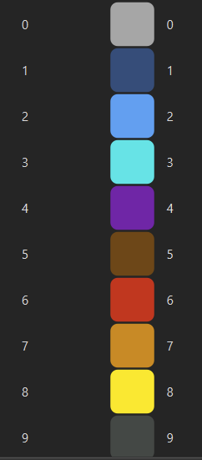
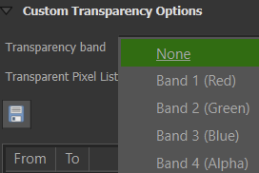
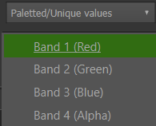
Challenges and Initial Feedback for Aiyin
5. After exporting as a GEOTIFF file, the documentation of the package is not clear on how to visualize the data.
Each band represents a time interval. 4 time intervals = 4 bands. We individually displayed each band in a layer to recreate the output shown in the program.
We also had to remove the QGIS default transparency band to visualize results

Slide 45
Remaining Improvements to DynamicPATCH
We recommend that Aiyin adds an argument that enables the user to scale the output graphs
When using the GUI, the 4 and 8 connectivity option does not make a difference. The program defaults to 8 connectivity.
Trying to export the maps using the command-line argument “export = true” as a .geotiff doesn’t work and the graphs do not display

Slide 46
References
Blue Forests. (n.d.). Our approach. Blue Forests. Retrieved November 17, 2024, from https://blue-forests.org/en/about-us/our-approach/
Bryan-Brown, D. N., Connolly, R. M., Richards, D. R., Adame, F., Friess, D. A., & Brown, C. J. (2020). Global trends in mangrove forest fragmentation. Scientific reports, 10(1), 7117.
Zhang, A. (2020, July 6). DynamicPATCH (Version 1.0) [Software]. GitHub. https://github.com/zay1996/DynamicPATCH
Zhang, A. (2024). Novel methods to characterize spatially-explicit patch dynamics on a landscape [Slideshow].

